Slide 1
Cat-tastic Case Study
Brian Littrell

Slide 2
Table of Contents
Introduction
Overview
Problem Definition
Users & Audience
Roles & Responsibilities
Scope & Constraints
Process
Market Research & Competitive Analysis
User Research & Interviews
Ideation
Prototyping
Affinity & Usability Testing
Iteration
Outcomes
Results
Challenges
Lessons Learned
Opportunities

Slide 3
Introduction
Overview
Problem Definition
Users & Audience
Roles & Responsibilities
Scope & Constraints
Setting the stage

Slide 4


Overview
Form abandon rates are notoriously high, roughly 70% of site visitors will abandon a signup form forever if they encounter an issue with it. Our solution was to improve the signup flow saving users time and effort while driving additional revenue for the business.
Notes:
A one or two sentence description of your problem definition and the solution you arrived at. Show the solution upfront and work backwards from there.

Slide 5
Problem Definition
Across all social media platforms users collectively visit their signup landing page and abandon the signup form. This is a problem because for many businesses, form conversion are a key business-success metric. Form abandonment can lead to lost sales, missed opportunities and wasted time and money.
Notes:
The problem definition you choose will go here. Try not to expand on it too much on this slide, that’s what the rest of the case study is for.

Slide 6
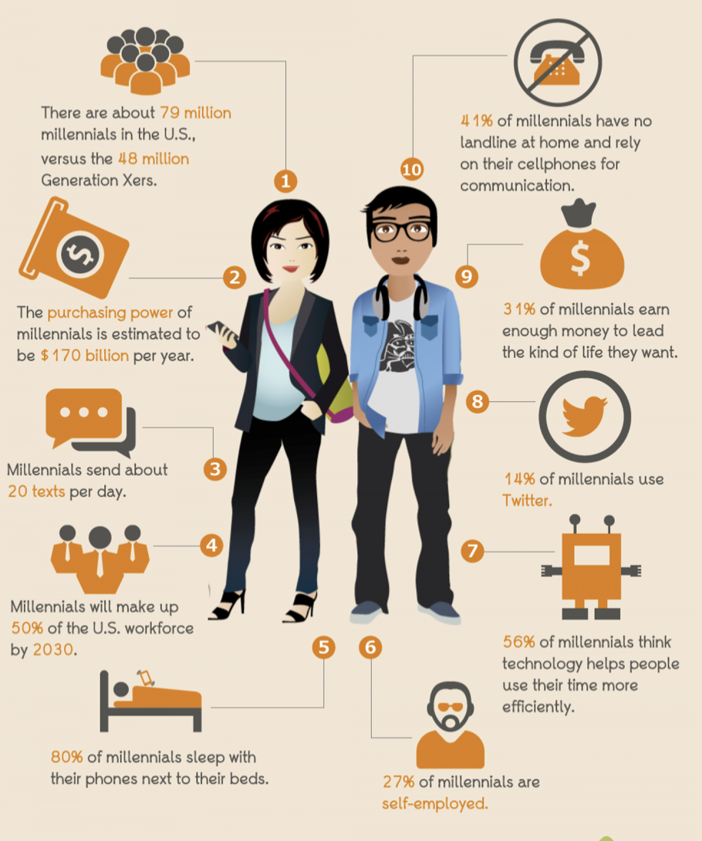
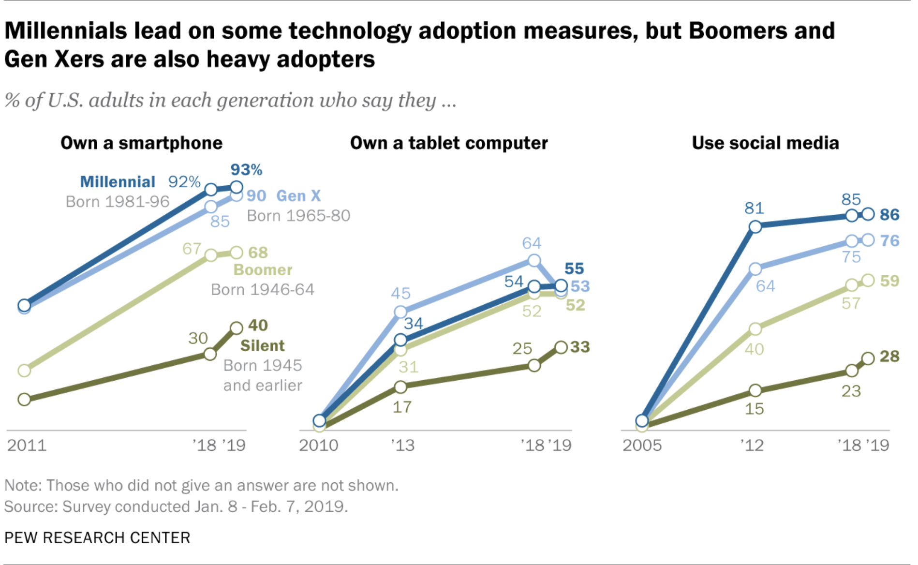
Users & Audience
Demographic Focus:
Millennials (born:1980s-1990s)
Millennials have been described as the first global generation and the first that grew up with the internet.
Notes:
• Describe the group(s) of people who would use the solution you created to solve a problem they have.
• Share what you know and have learned about them.

Slide 7

Roles & Responsibilities
UX Researcher (Empathize)
Responsible for qualitative and quantitative research
UX Strategist (Empathize/Define)
Responsible for qualitative and quantitative research
Responsible for breaking down the research to inform a design solution or wireframes
UX Specialist (Empathize/Define/Prototype)
Responsible for qualitative and quantitative research
Responsible for breaking down the research to inform a design solution and wireframes
UX Designer (Empathize/Define/Prototype)
Responsible for qualitative and quantitative research
Responsible for breaking down the research to inform a design solution and wireframes
UI Designer (Prototype)
Responsible for the design solutions
Product Manager (Empathize/Define)
Responsible for qualitative and quantitative research
Responsible for breaking down the research to inform a design solution or wireframes
Knowledge of computer science
Analyst (Empathize)
Responsible for gathering quantitative data and contributed to the decision making by providing performance insights.
Notes:
Take this slide to describe who played what role, and who was responsible for what.
For this course, you are a UX team of one. It will all be on you.
In the future, you will be able to break it down into various roles that can specialize in one or two aspects of the work.

Slide 8
Scope & Constraints
Preliminary Product Vision – Improve the signup flow experience to save users time and effort while driving additional revenue for the business. Key Results: 25% increase of customers signup, a 20% increase in conversion rate and 30% decrease in form abandonment.
Technical Constraints and Opportunities – Innovation and new technology will not be introduced due time timing.
Deliverables – Signup flow experience within the following phases (Empathize, Define, and Ideate) within 4weeks. Test phase will be out of scope for this project
Budget – N/A
Stakeholders Target Audience: Millennials (born:~1980s – 1990s)
Notes:
Tell us about the parameters of the work and any special circumstances or limitations that influenced the solution you created.
For example, your solution might have been required to have a physical presence in a specific location.
Or, the solution needed to fit into an existing application.

Slide 9
Team Collaboration
Zoom
What we did – A video conferencing platform
Why we did it – Allowed team members to connect online for video conference meetings
How we did it – Meeting were scheduled/conducted on weekly basis
Meeting Minutes:
What we did – Official record of actions
Why we did it – Serve as historic purpose and document the most important points discussed during team meeting (attendance, agenda, action items, decisions, and agreements).
How we did it – Created in a Word, information was documented then distributed on team Slack channel to keep team members informed and on point.
Notes:
Who else has this problem?
What other solutions are out there?
Who is using them?
How are they performing?
What are their flaws?
Where are the opportunities for this solution?

Slide 10
Team Collaboration – Continued
Standups
What we did – Daily short meeting/update
Why we did it – Helps ensure a short check-in rather than a lengthy discussion to go over important task that have been finished, in progress and may show roadblocks faced.
How we did it – Meetings were not physical standups as intended rather distributed through team Slack channel for quick update.
Slack:
What we did – A messaging program platform
Why we did it – Messaging program for our team that connects information to our team.
How we did it – A team channel was created so only team members could access and have direct access.
Notes:
Who else has this problem?
What other solutions are out there?
Who is using them?
How are they performing?
What are their flaws?
Where are the opportunities for this solution?

Slide 11
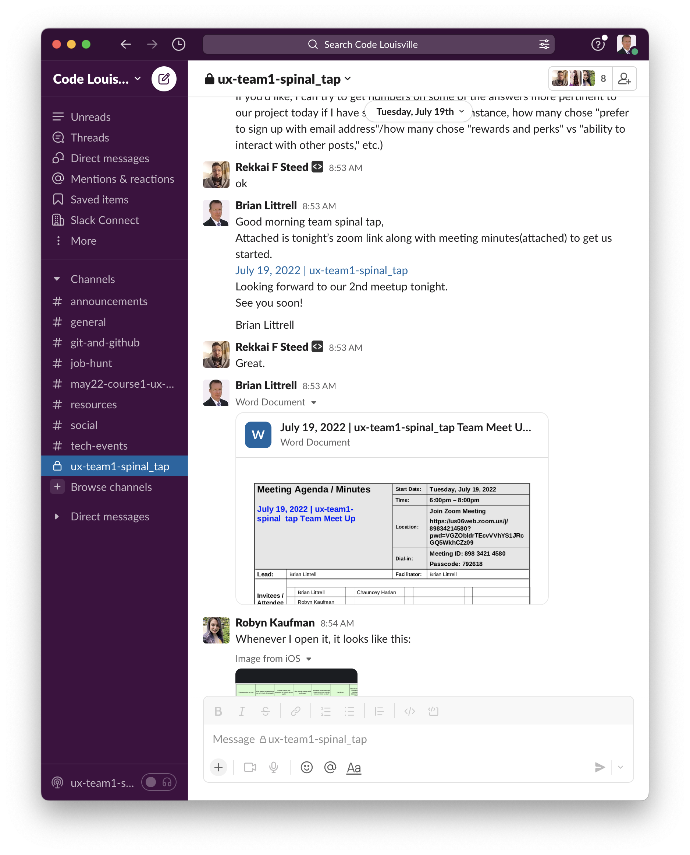
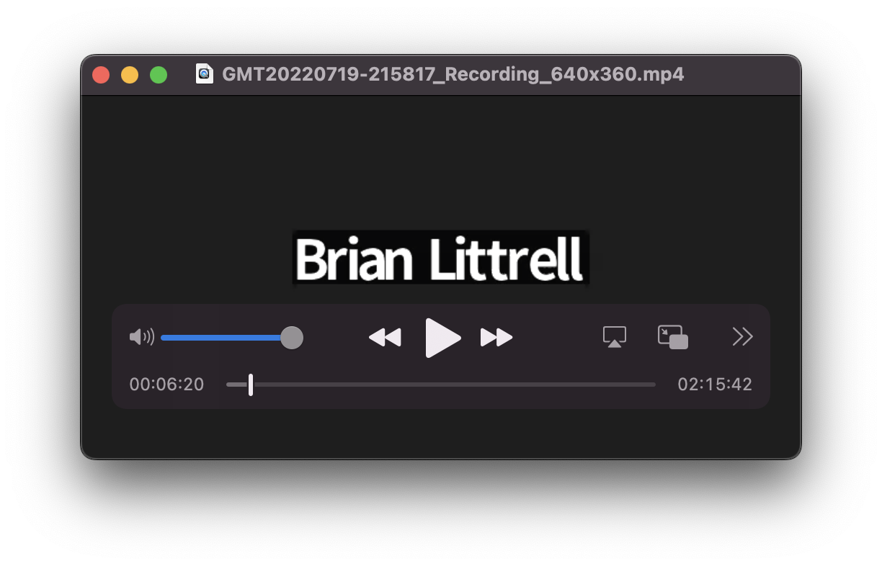
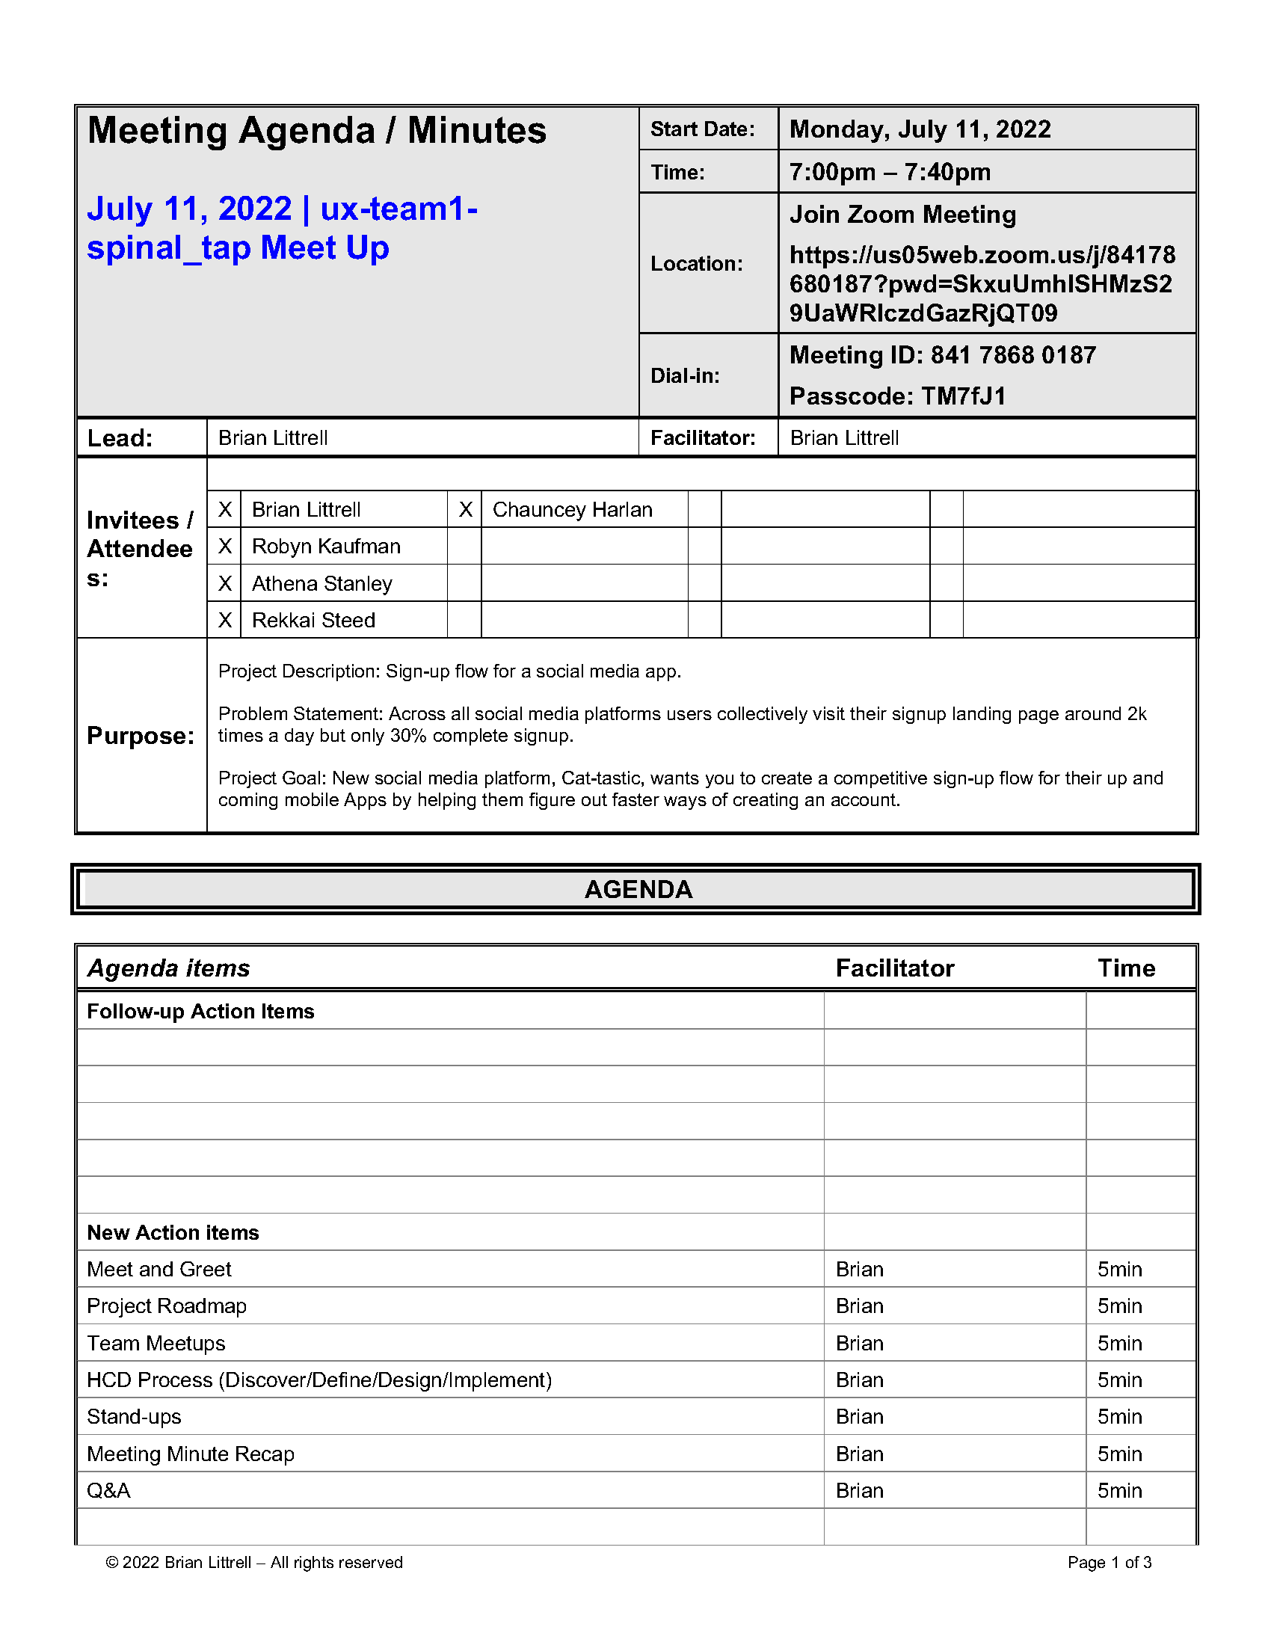
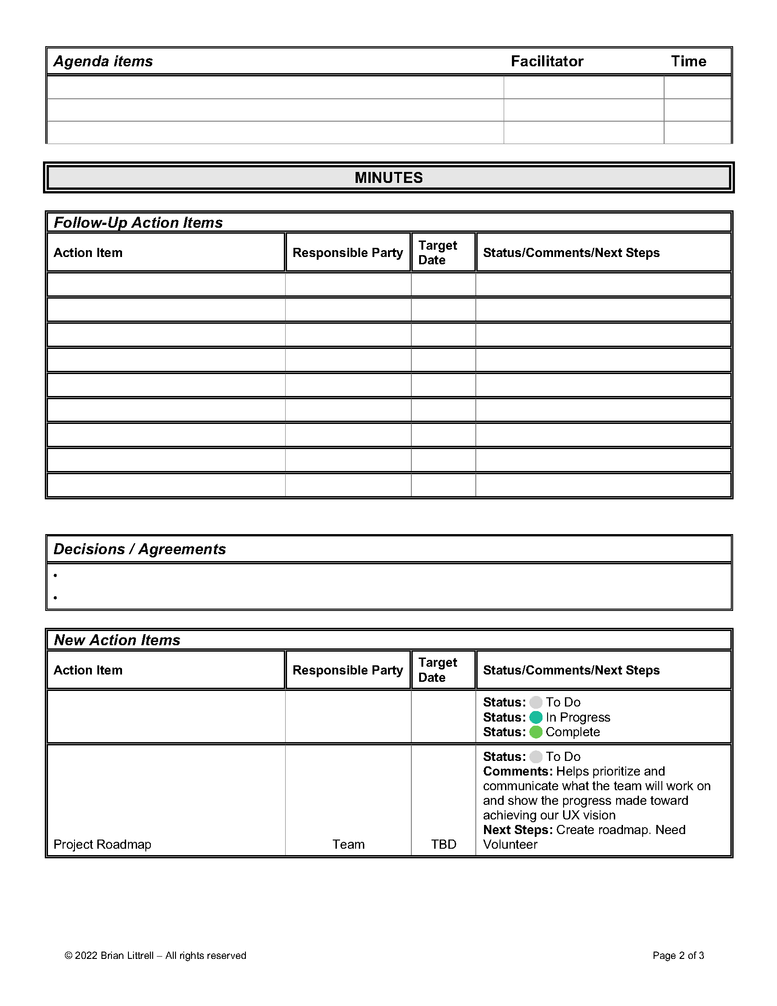
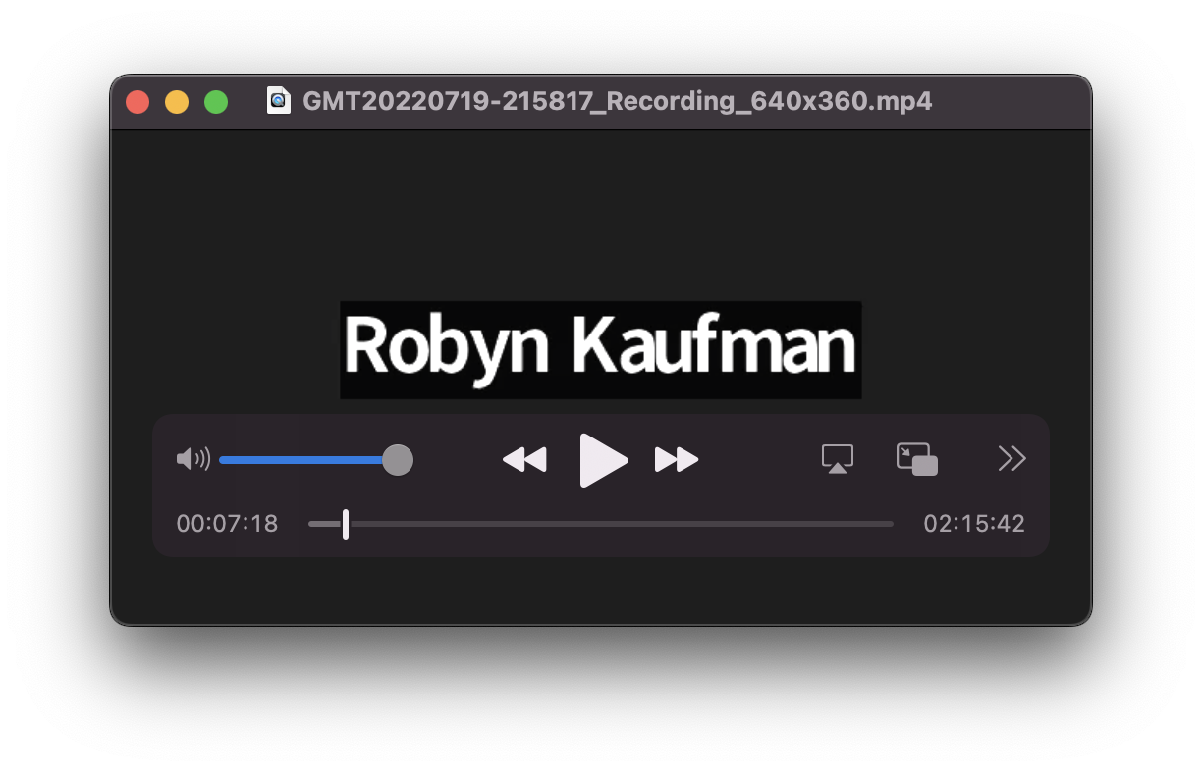
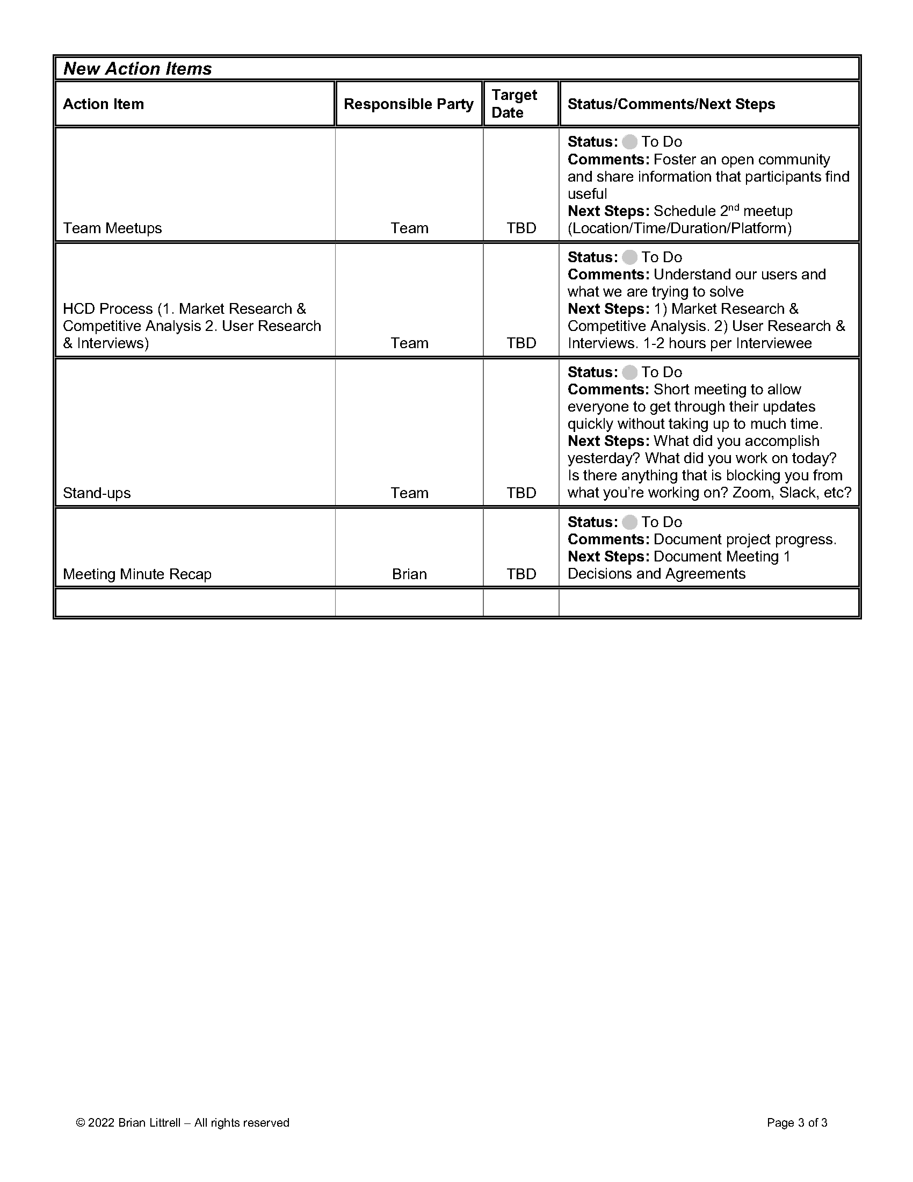
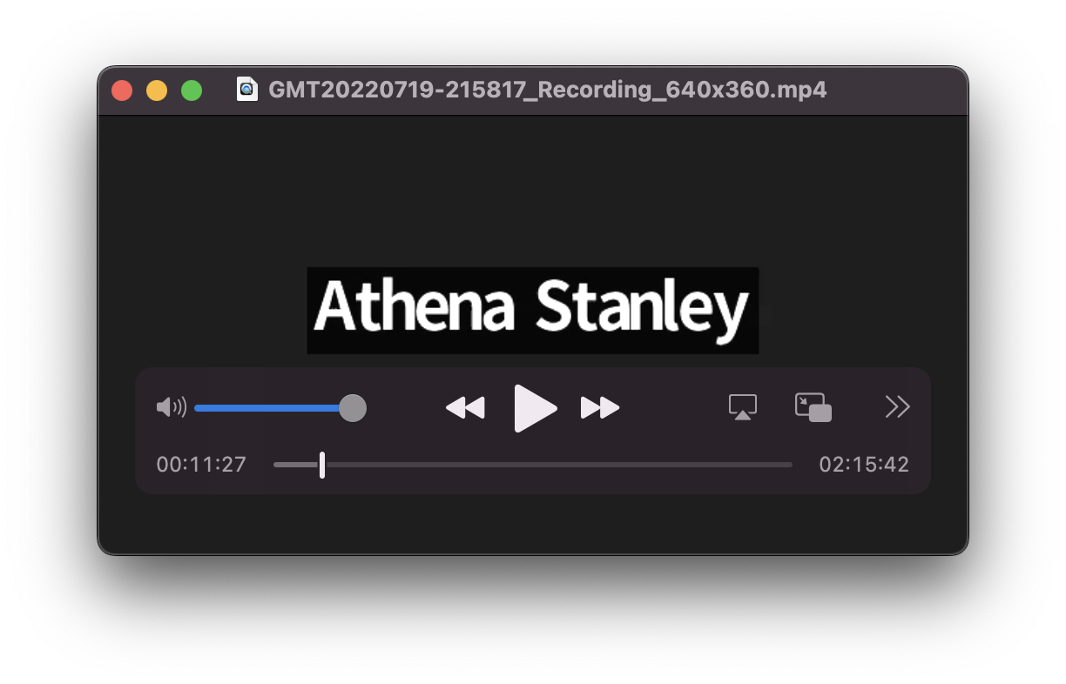
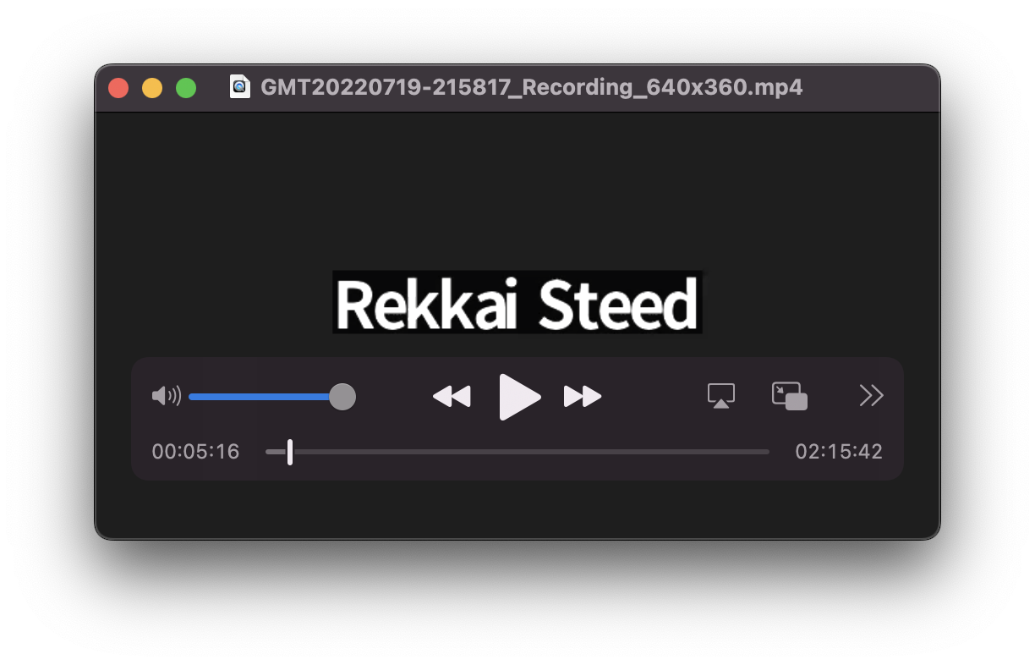
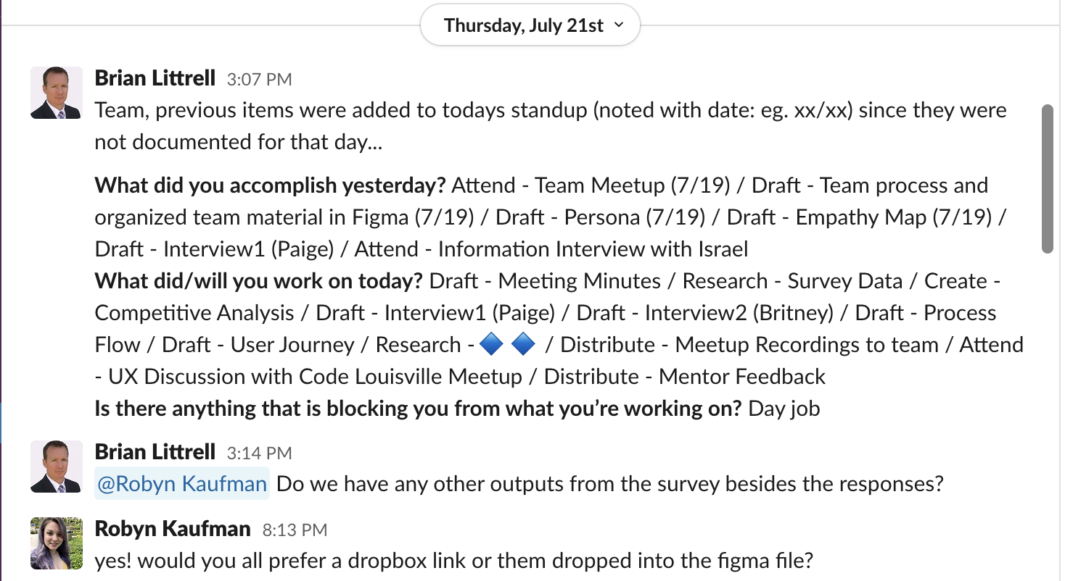
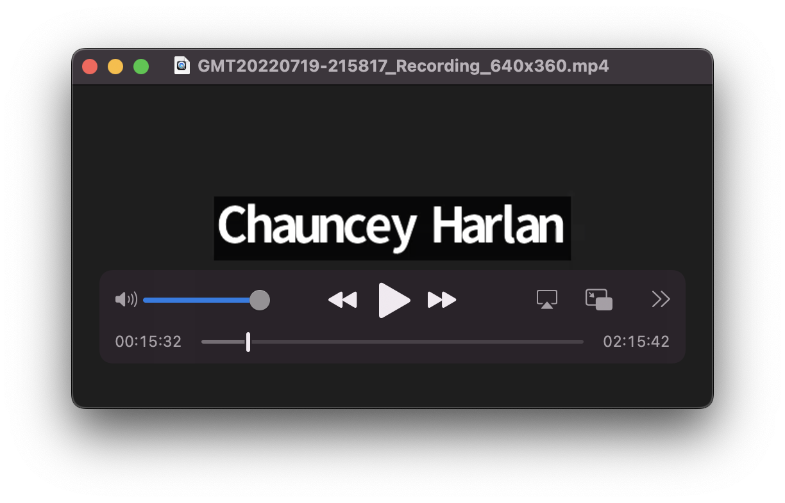
Notes:
Add photos and screenshots of your research

Slide 12
Process
Market Research & Competitive Analysis
User Research & Interviews
Ideation
Prototyping
Affinity & Usability Testing
Iteration
What happened, and why

Slide 13
User Centered Design Framework
What we did – We used a design-thinking framework process that people follow when performing a repeatable activity or activities
Why we did it – Efficient way of providing a consistent high-quality outcome regardless of the person providing the service
How we did it – Empathize > Define > Ideate > Prototype > Test
Milestones:
Week 1 – Empathize (Discovery) Phase
Week 2 – Define (Understand) Phase
Week 3 – Ideate (Explore) Phase
Week 4 – Prototype (Make) Phase
Notes:
Who else has this problem?
What other solutions are out there?
Who is using them?
How are they performing?
What are their flaws?
Where are the opportunities for this solution?

Slide 14
Market Research & Competitive Analysis
What we did – We researched: market, competitors, and relevant technologies
Why we did it – To better understand the landscape we reviewed existing work and products
How we did it – Internet research
Milestones:
Week 1 – Empathize (Discovery) Phase
Week 2 – Define (Understand) Phase
Week 3 – Ideate (Explore) Phase
Week 4 – Prototype (Make) Phase
Notes:
Who else has this problem?
What other solutions are out there?
Who is using them?
How are they performing?
What are their flaws?
Where are the opportunities for this solution?

Slide 15
Market Research & Competitive Analysis
Most industries have form abandonment
Travel – 81%
Non-profit – 77.9%
Finance – 75.7%
Retail – 75.8%
Some industry solutions include:
Only require signup when necessary – Sign up form as first screen can deter user from using
Include social login (Facebook, Google, etc) – Allows user to skip form
Top align labels – Users fills out form faster – Good UX accessibility.
Show value – Clearly define the value application brings.
Kill the confirm password field – Lowers conversion rates. Typically mask user input.
Define text field styles – Provides feedback to user
Notes:
Who else has this problem?
What other solutions are out there?
Who is using them?
How are they performing?
What are their flaws?
Where are the opportunities for this solution?

Slide 16
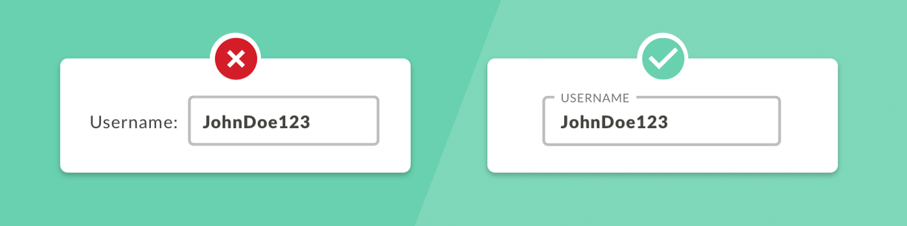
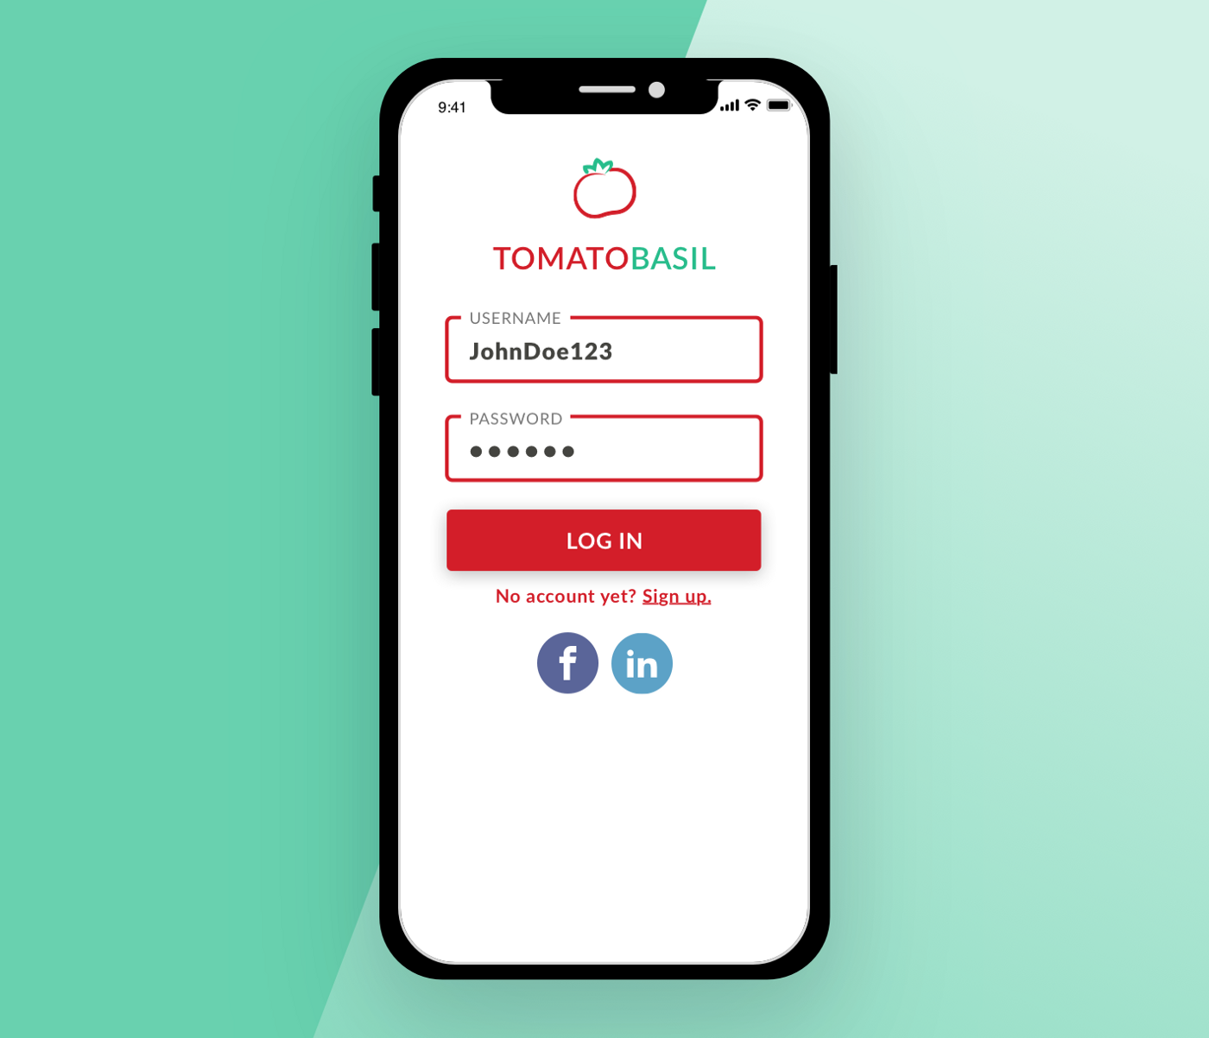
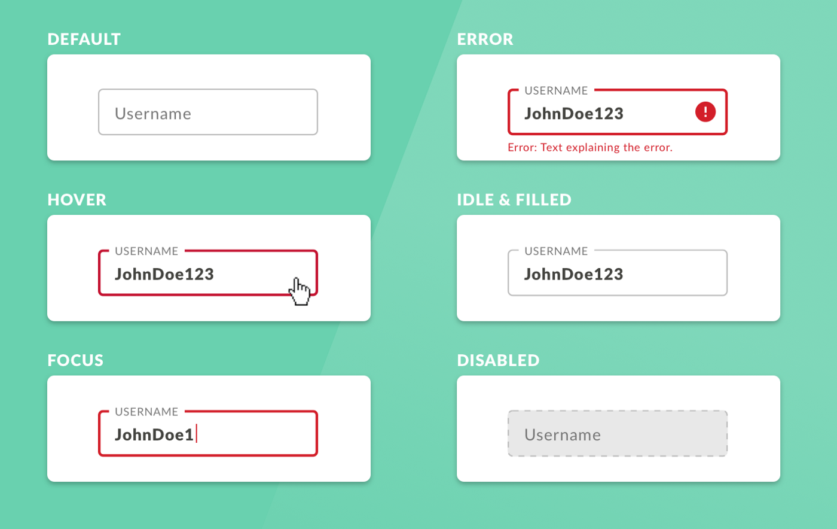
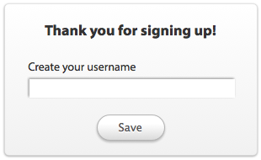

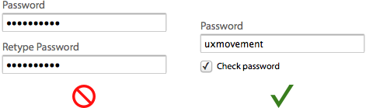
Notes:
Add photos and screenshots of your research

Slide 17
User Research & Interviews
What we did – We used a two-step process where we interviewed users, or anyone else who has investment or interest in product’s success
Why we did it – Understand users’ needs, behaviors, motivations and pain points
How we did it – Qualitative and Quantitative Research:
Milestones:
Week 1 – Empathize (Discovery) Phase
Week 2 – Define (Understand) Phase
Week 3 – Ideate (Explore) Phase
Week 4 – Prototype (Make) Phase
Notes:
Who did you talk to?
Why did you talk to them?
What did you learn?
What sort of frustrations did they have?
What was a highlight or striking quote from the interviews?
What surprised you most?

Slide 18
User Research & Interviews - Continued
Qualitative Research – 1:1 Interviews
What we did – Qualitative research is based on unquantifiable traits or responses
Why we did it – Speaking with individuals are more forethcoming in a one-on-one setting
How we did it – Created discussion guide to stay on point. Also conducted a contextual observation and watched them while they work to understand how they operate to as simply as launching a program that captures recordings of an interface being used in the wild. Goal in this activity is to understand what it’s like to walk a mile in the shoes of the customer. Used video recording to capture anything missed or found beneficial for further investigate. Documented findings after interview.
Notes:
Who else has this problem?
What other solutions are out there?
Who is using them?
How are they performing?
What are their flaws?
Where are the opportunities for this solution?

Slide 19
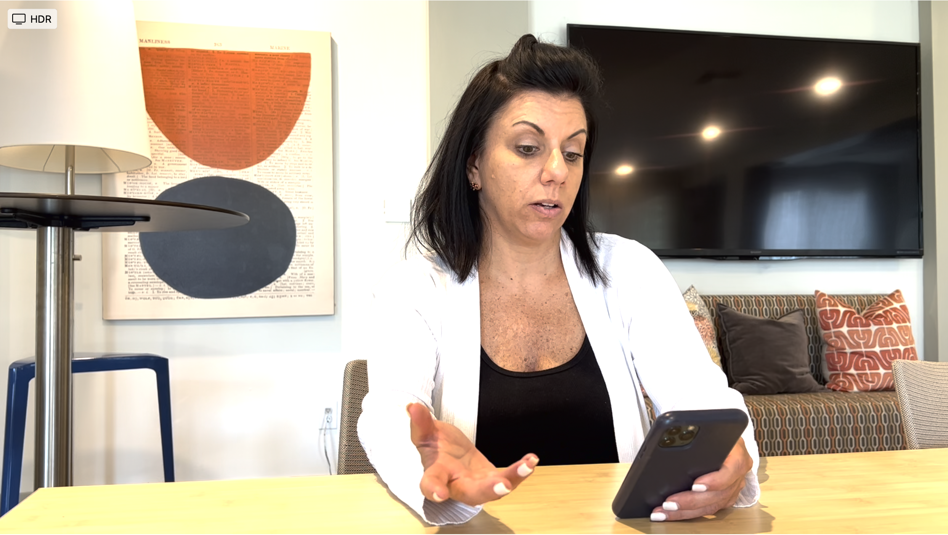
“I don’t want to commit to anything without checking it out first”
Notes:
Add your personas and/or photos and screenshots of your user research

Slide 20
User Research & Interviews - Continued
Quantitative Research - Surveys
What we did – Quantitative research uses numbers and statistics
Why we did it – Ability to identify trends and patterns
How we did it – We used Jotform a powerful online application that allows anyone to quickly create custom online forms. We extracted results from Excel and pdf to view analytics.
Notes:
Who else has this problem?
What other solutions are out there?
Who is using them?
How are they performing?
What are their flaws?
Where are the opportunities for this solution?

Slide 21
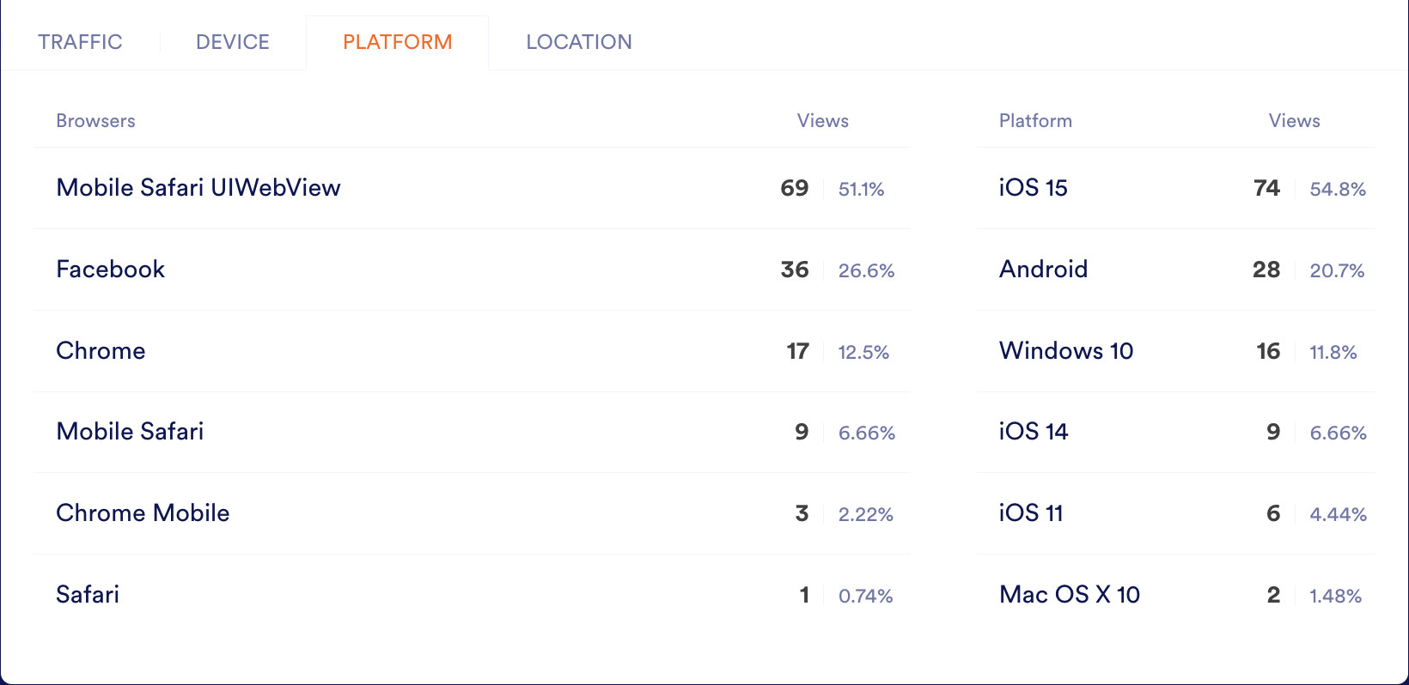
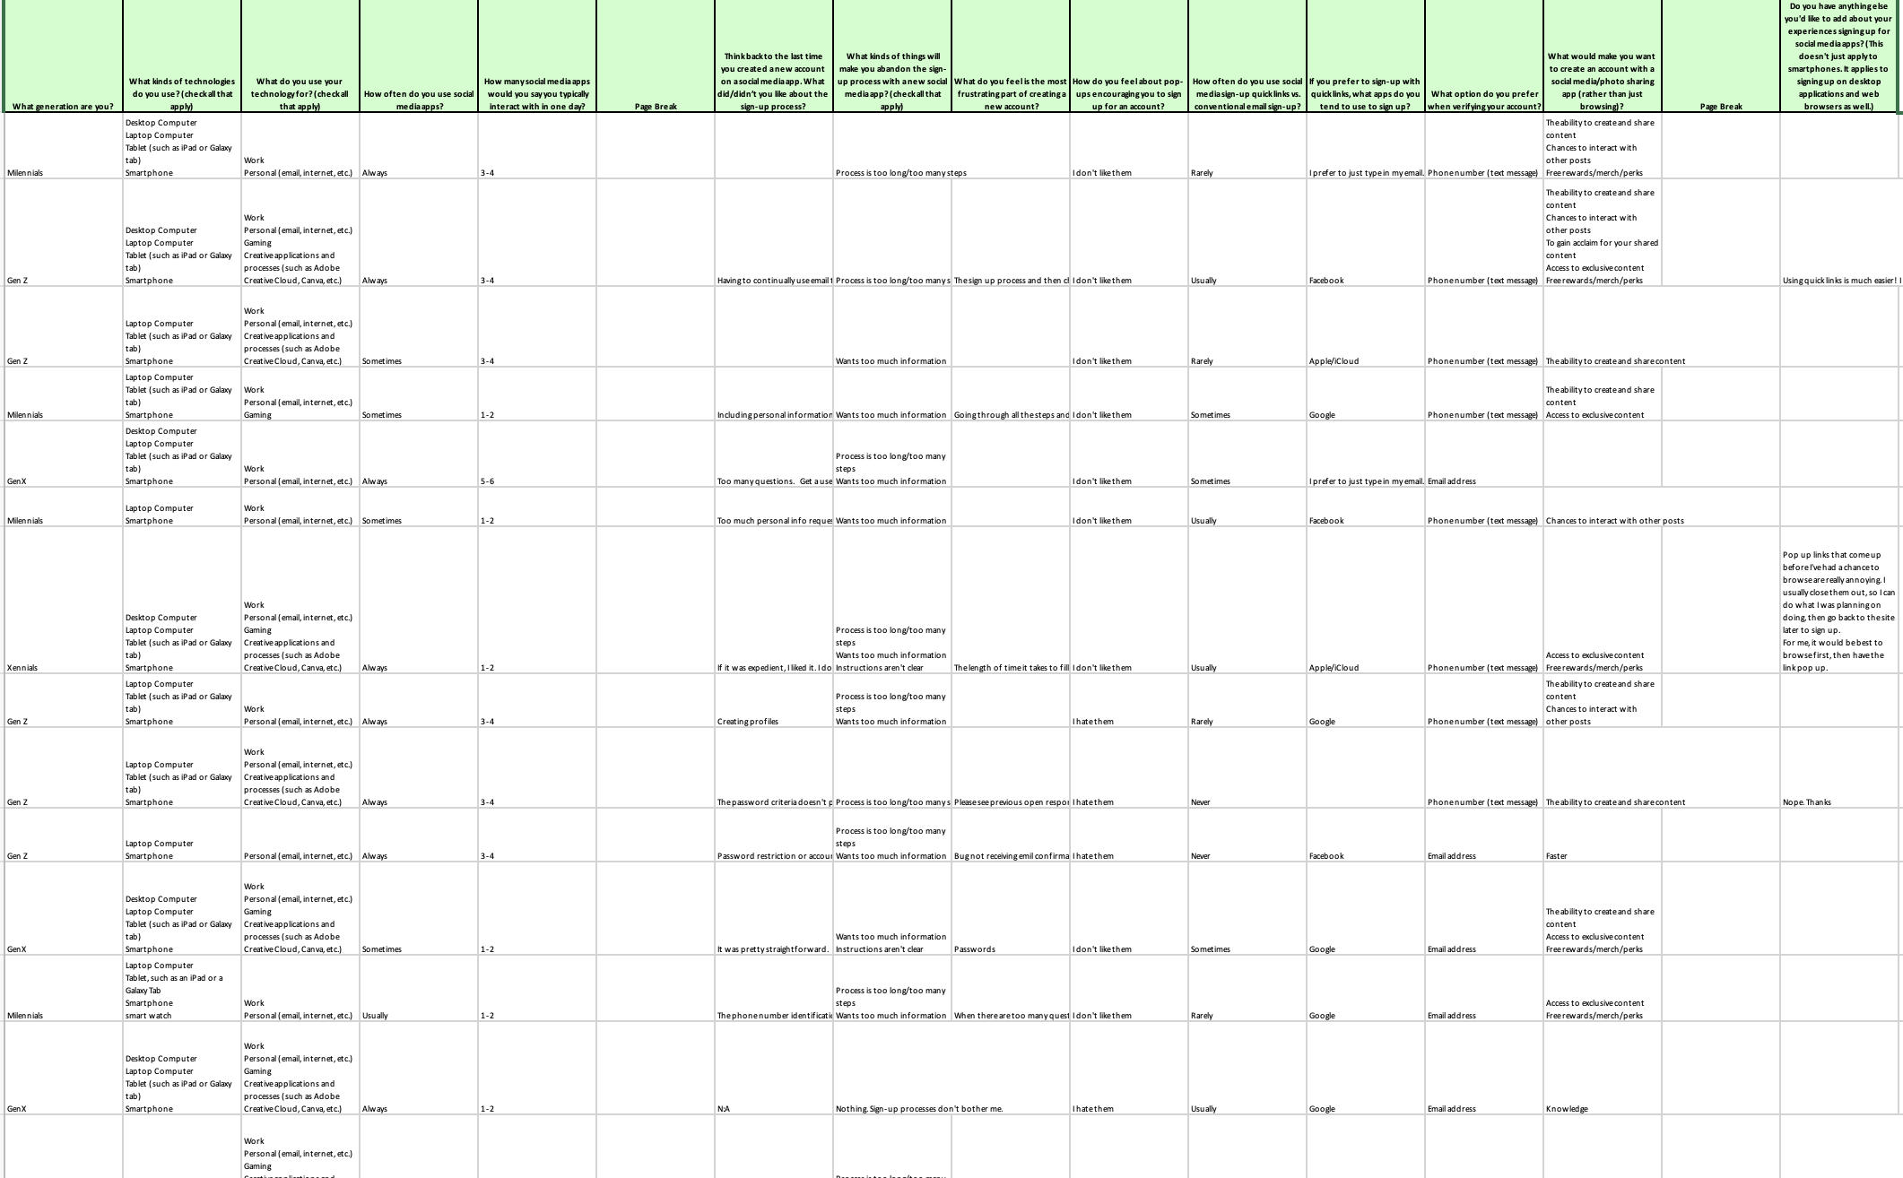
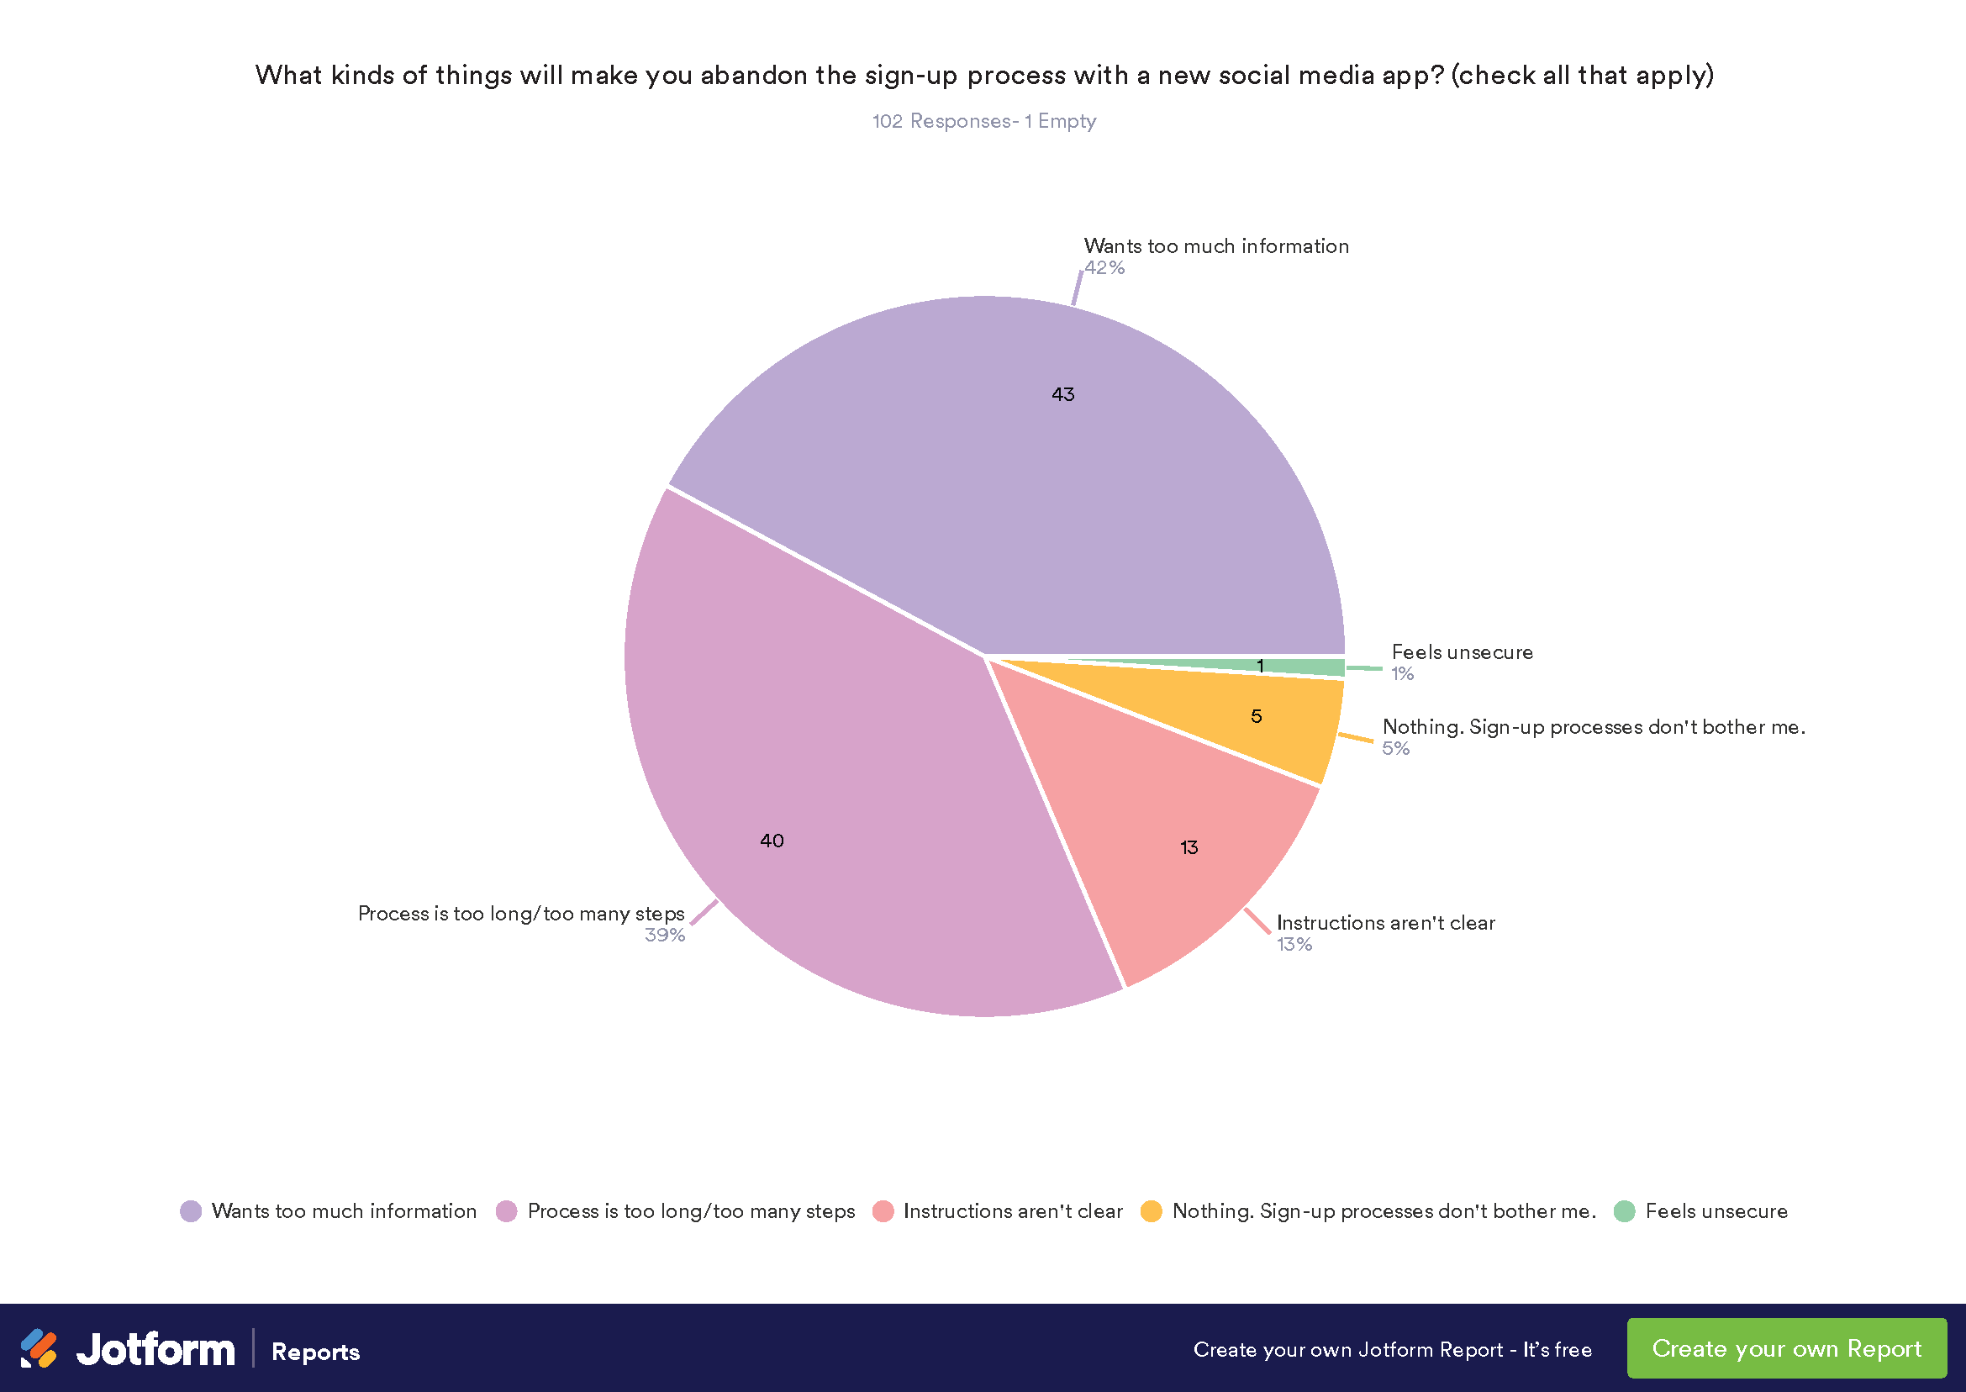
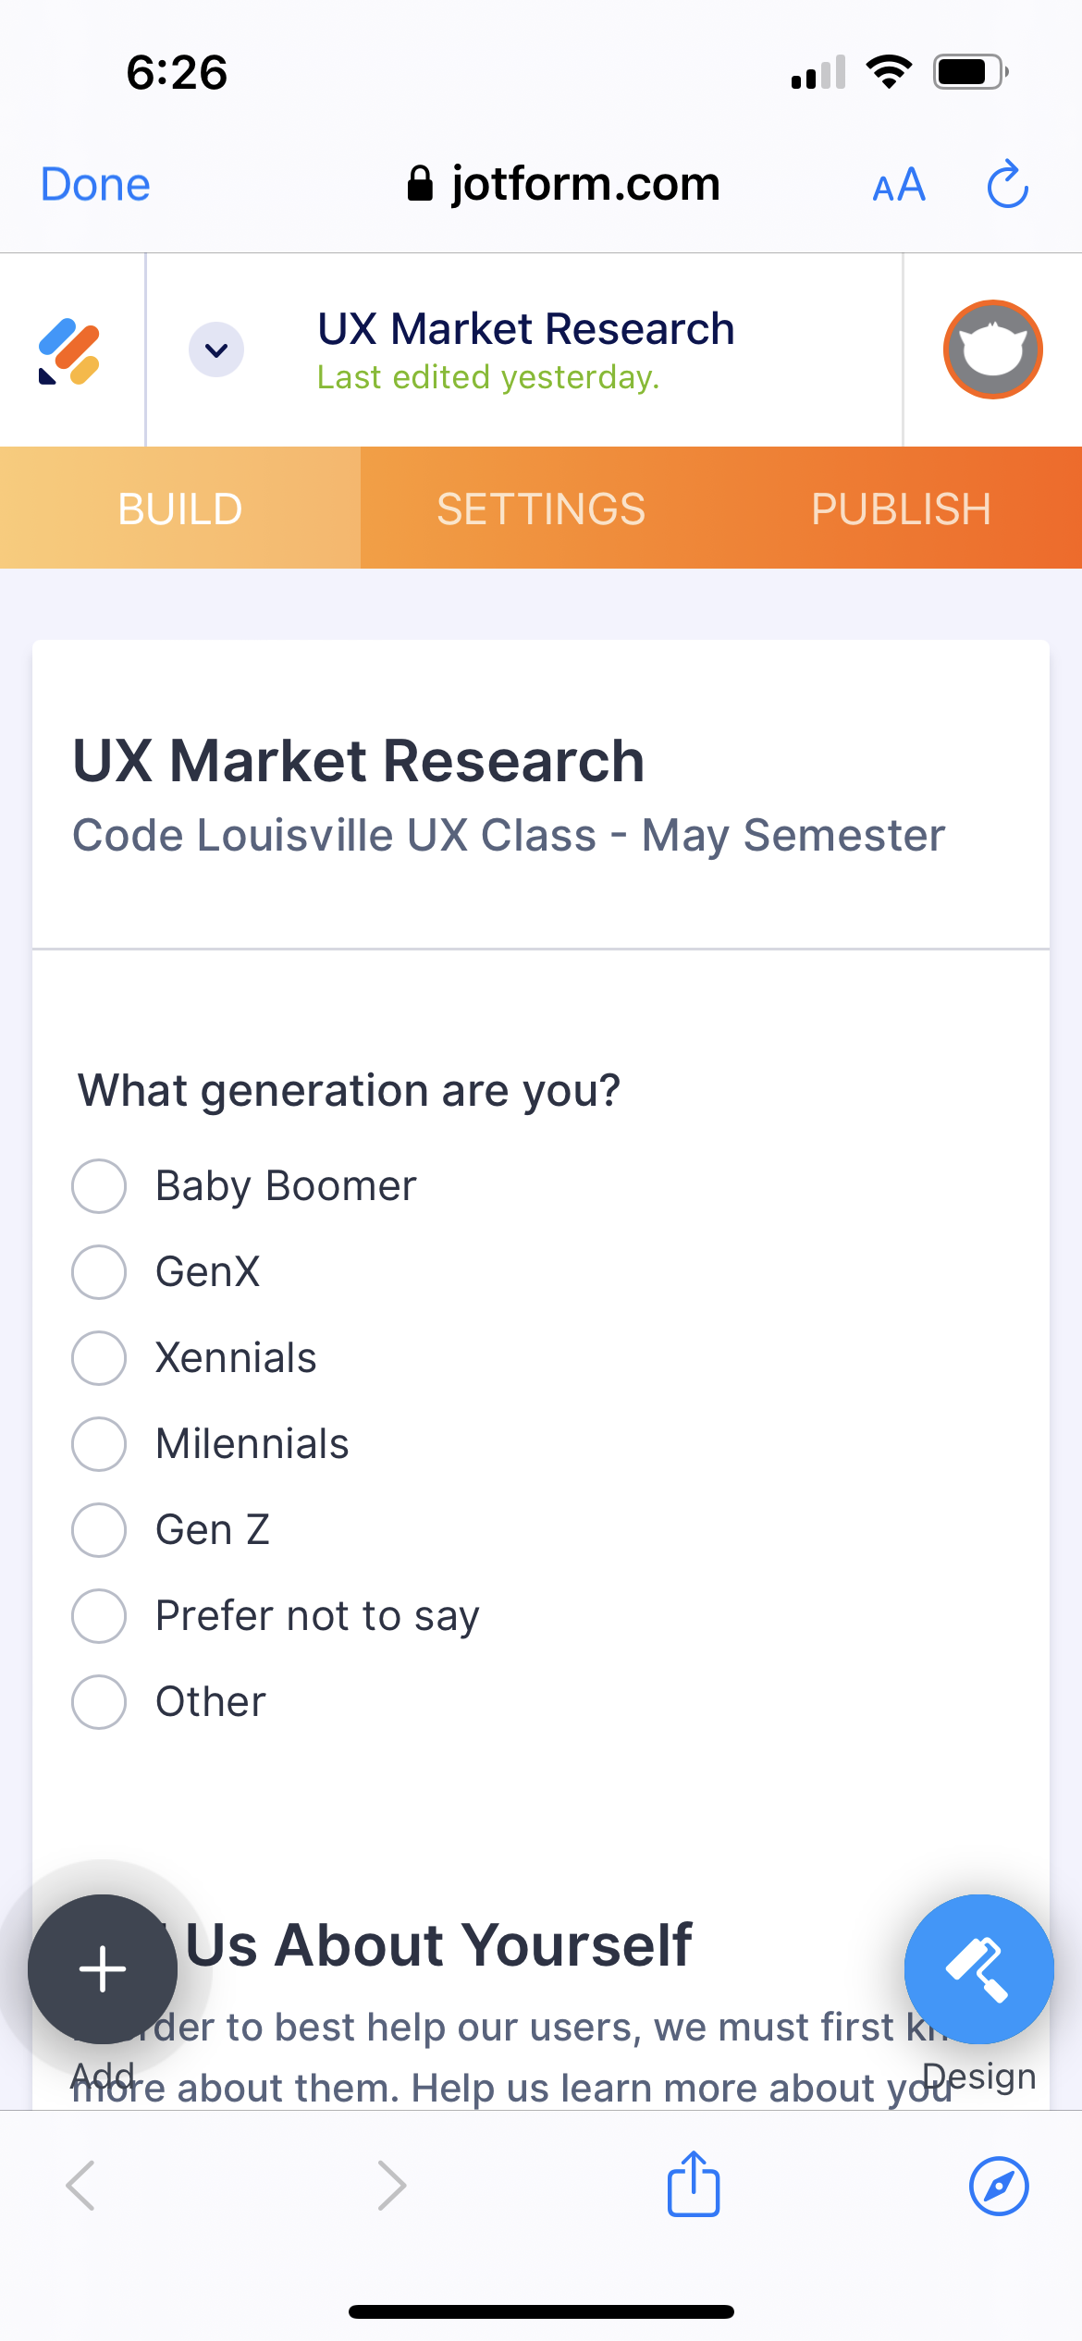
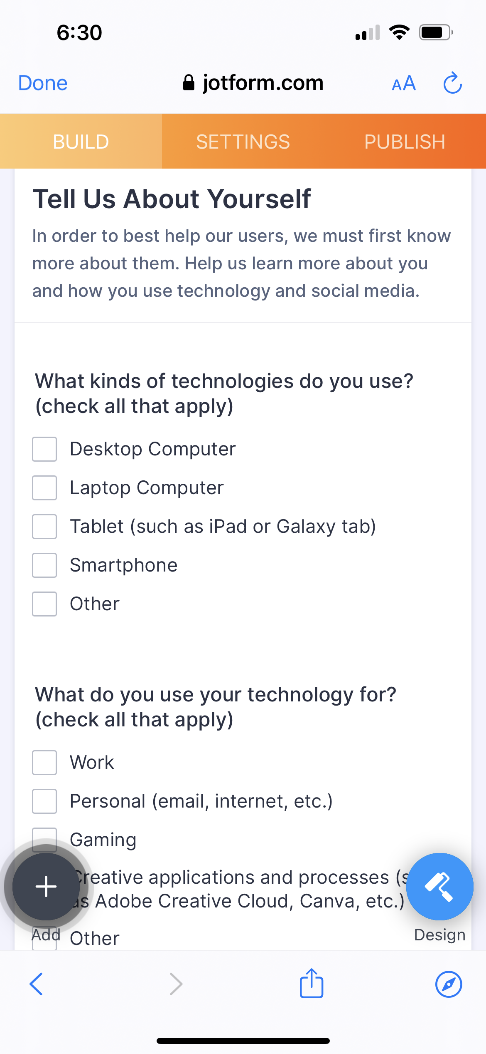
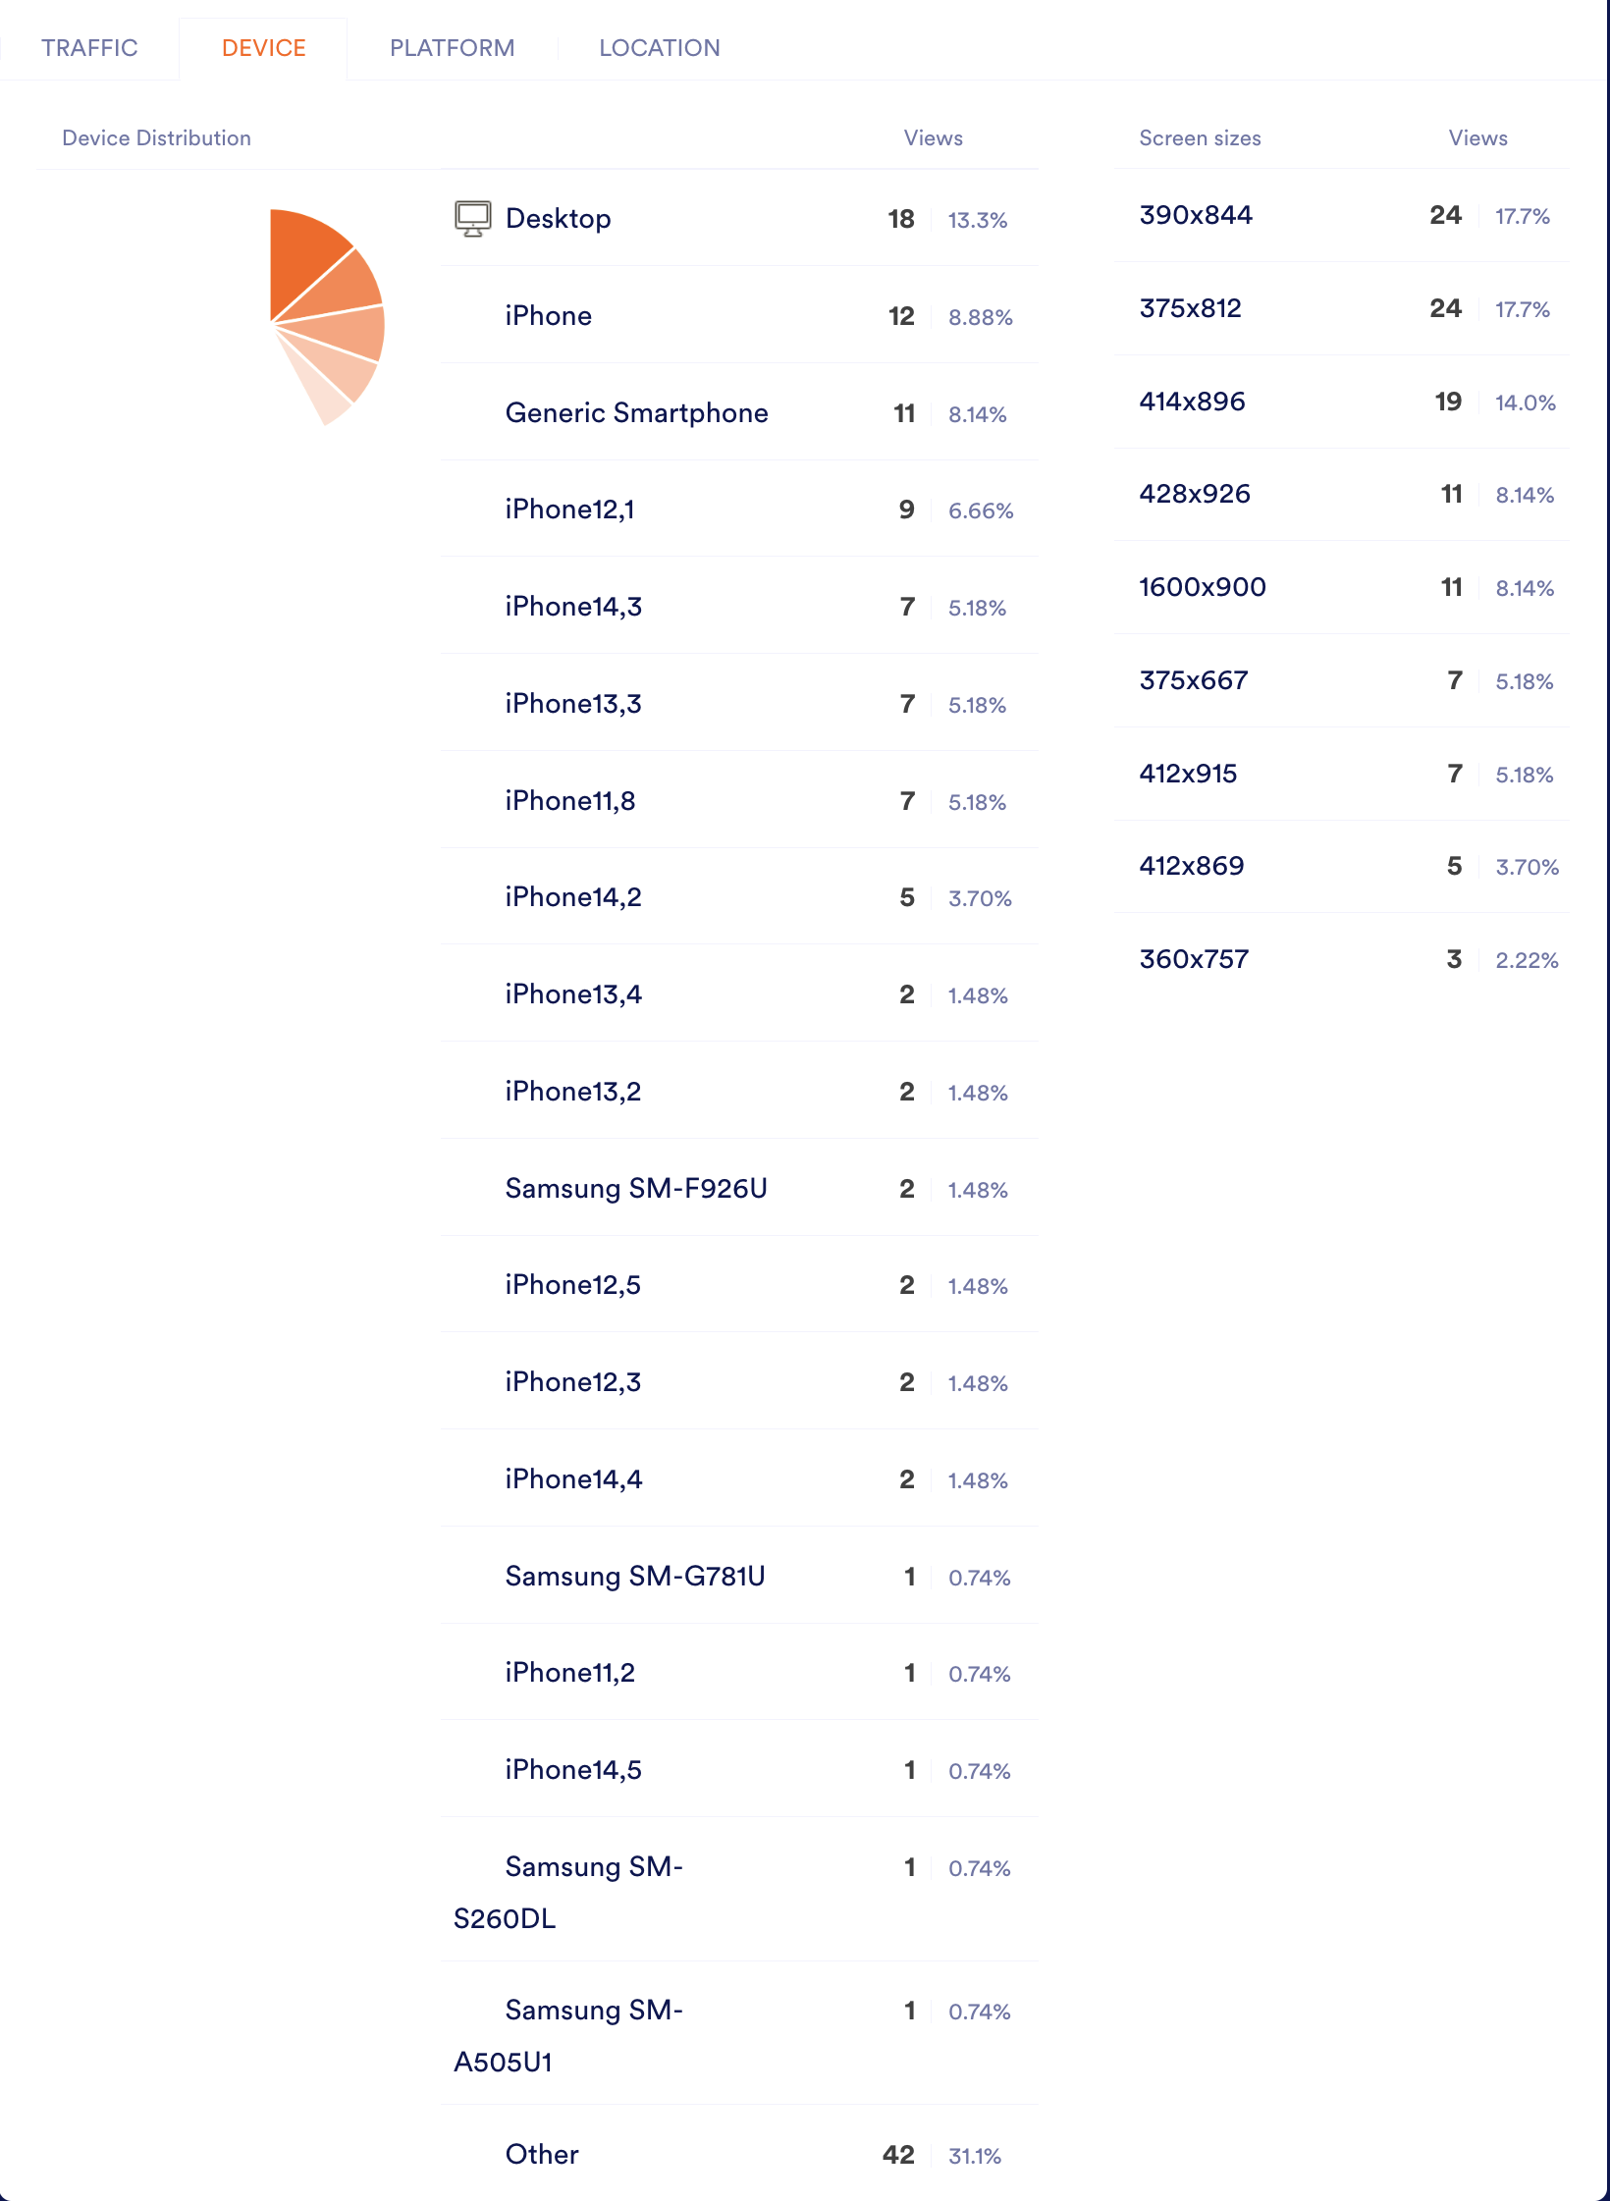
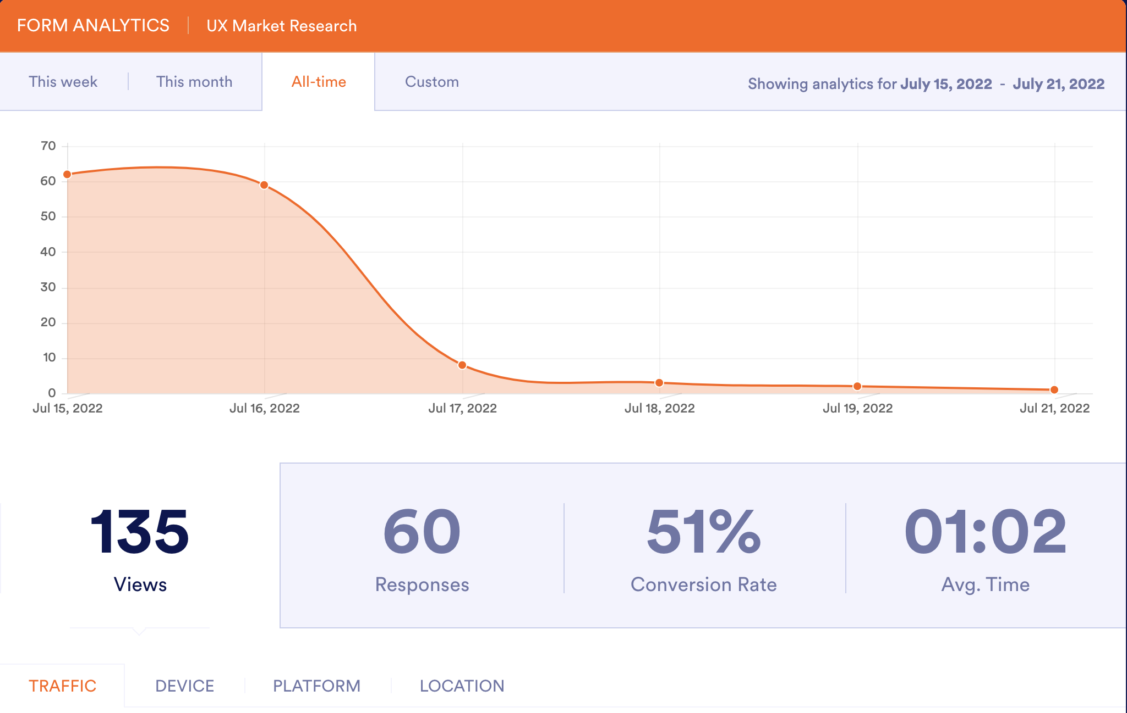

Slide 22
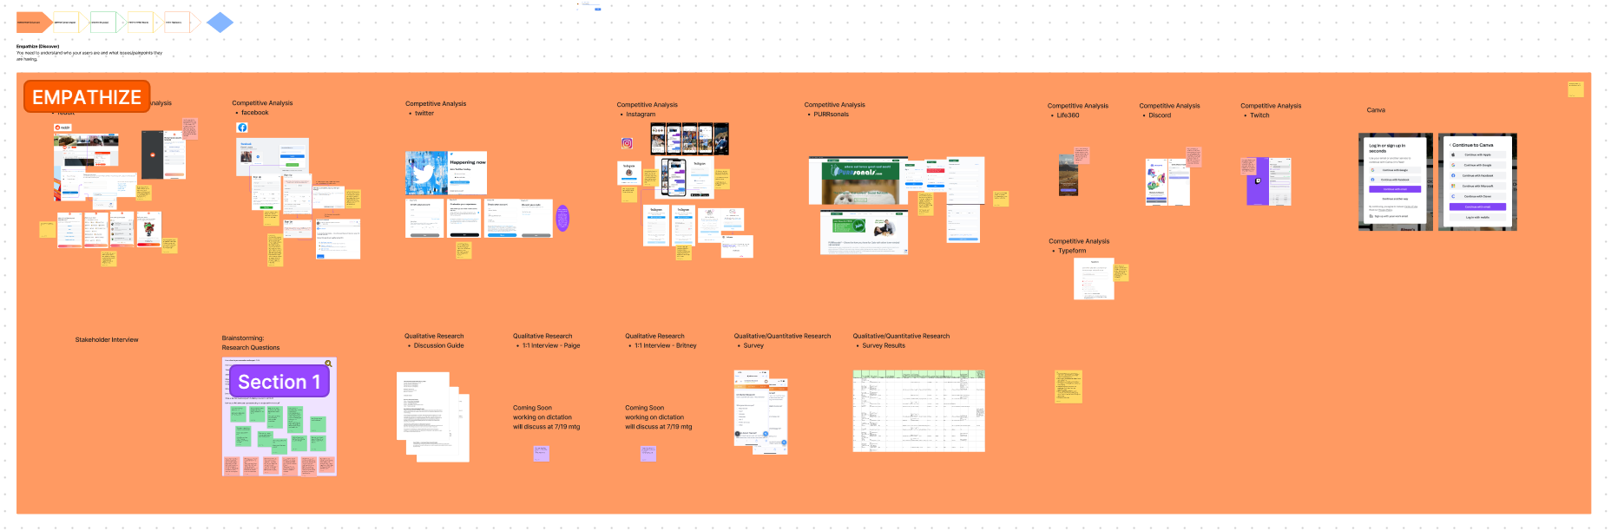

Slide 23
Define
What we did – Gather all findings, discovered common themes and patterns and what consistently came up as a challenge
Why we did it – To synthesize our observations about our user from the Empathy stage
How we did it – Created Persona, Empathy Map, Archytypes, Strategy document and journey map.
Milestones:
Week 1 – Empathize (Discovery) Phase
Week 2 – Define (Understand) Phase
Week 3 – Ideate (Explore) Phase
Week 4 – Prototype (Make) Phase
Notes:
Who else has this problem?
What other solutions are out there?
Who is using them?
How are they performing?
What are their flaws?
Where are the opportunities for this solution?

Slide 24
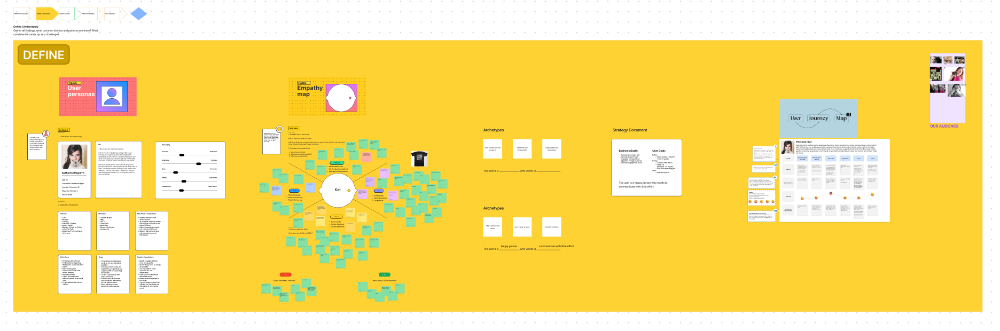

Slide 25
Ideation
What we did – We came up with wild ideas and best possible solutions, referencing our problem statement.
Why we did it – To generate as many ideas as possible.
How we did it – Brain dump and user flows, began wireframing.
Milestones:
Week 1 – Empathize (Discovery) Phase
Week 2 – Define (Understand) Phase
Week 3 – Ideate (Explore) Phase
Week 4 – Prototype (Make) Phase
Notes:
What process did you follow to generate ideas?
How many did you come up with?
How did you narrow them down?
Which ones did you pick to move forward with?

Slide 26
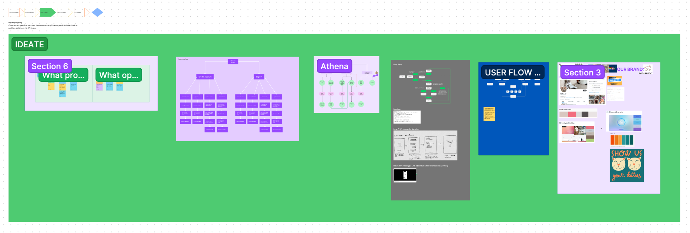

Slide 27
Prototyping
What I did – A simulation or sample version of the final software project
Why I did it – To enable interaction with a product to facilitate testing and gather feedback before launch
How I did it – First I created sketches on notebook from research (insights) avoid getting bogged down with the details or software. Next, I refined sketches from notebook to white bored. Finally, I created static low-fi wireframes in Figma. Since testing was out of scope, I skipped the paper prototype and functional prototypes where users are given scenarios for using the product.
Notes:
How did you approach making your prototype?
Did you make wireframes or sketches?
What were the requirements for the prototype?
What challenges did you face while making it?

Slide 28
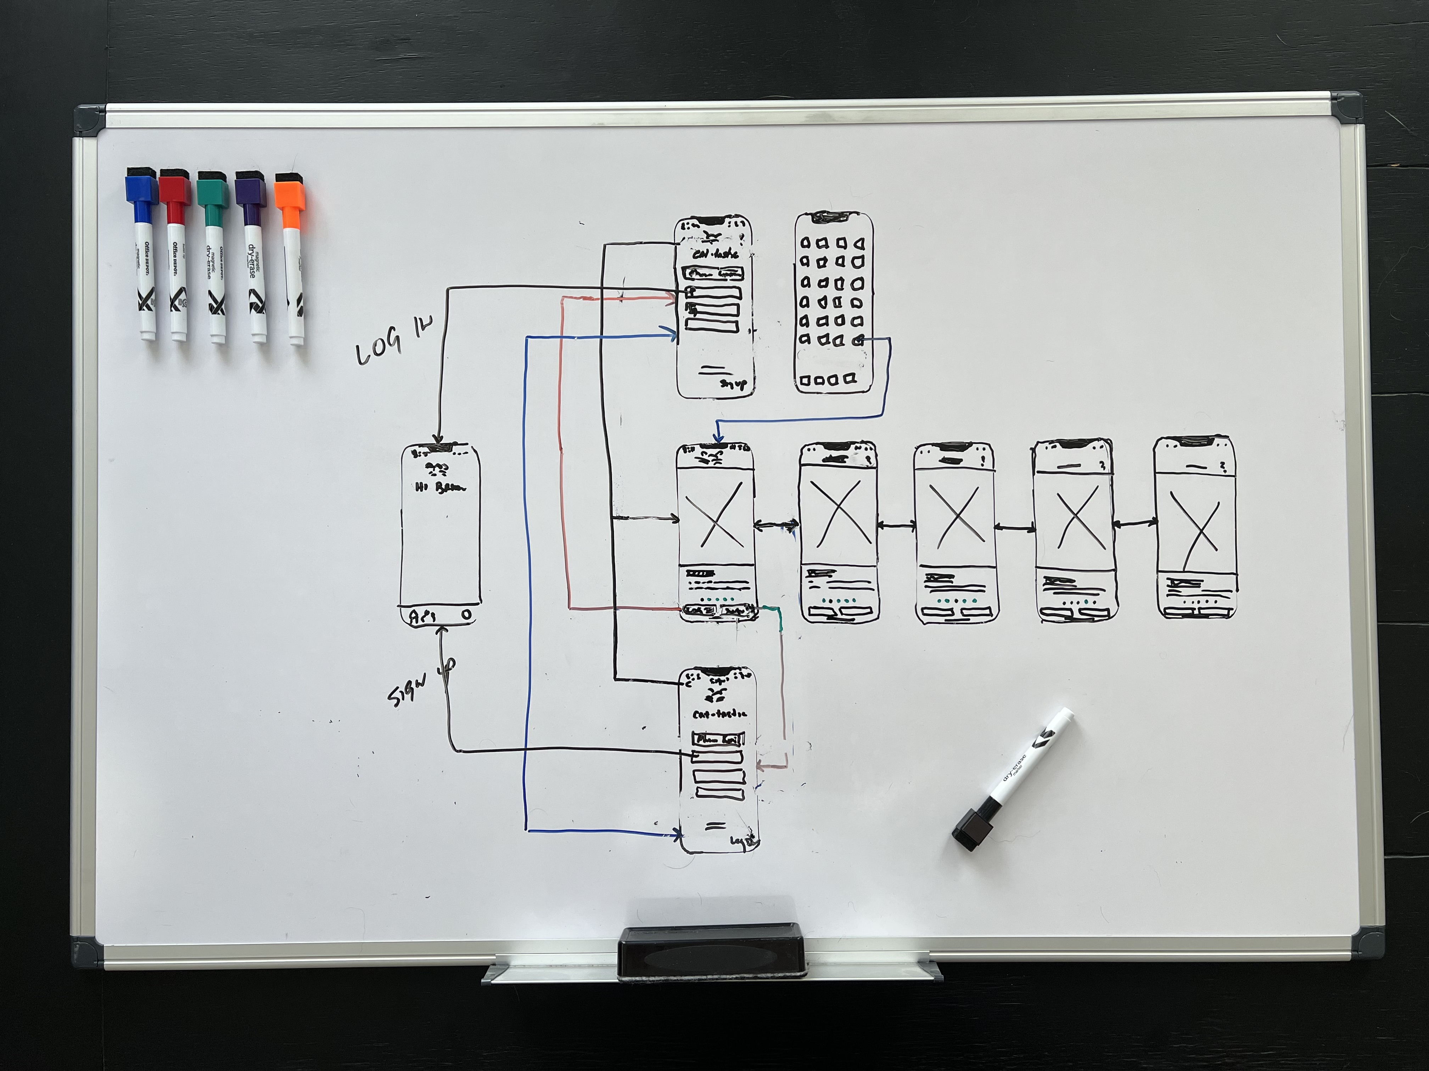
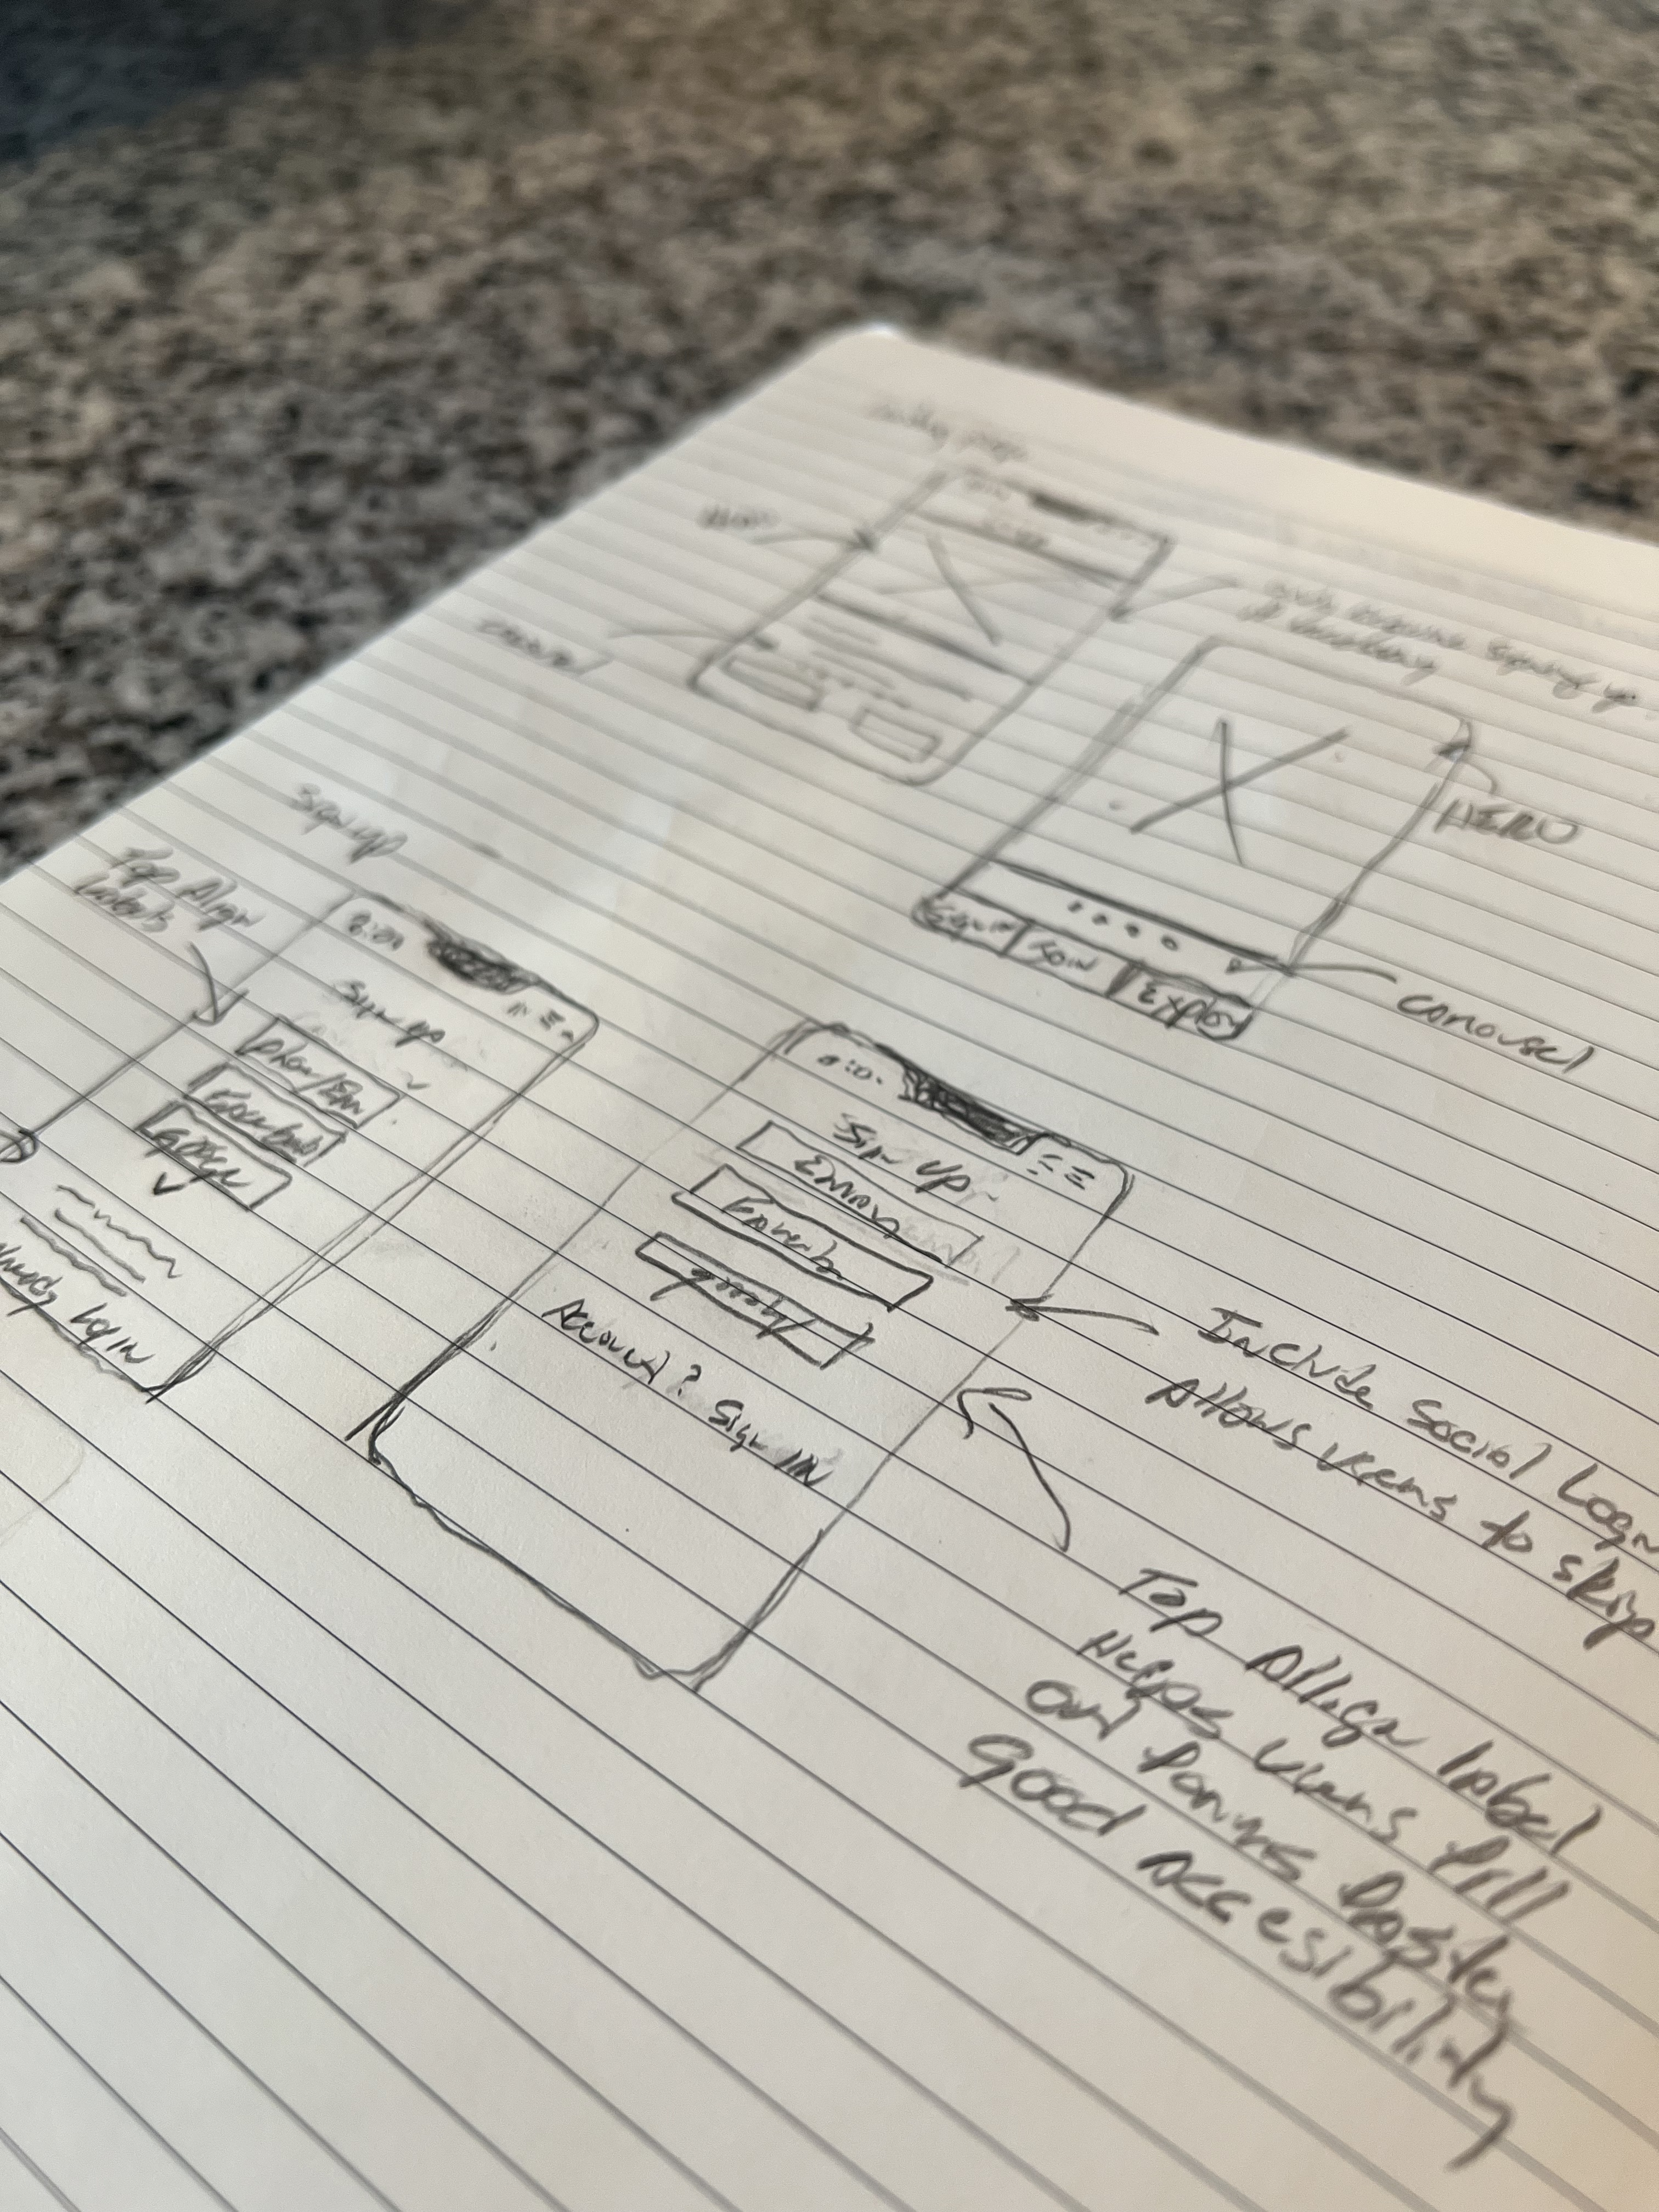
Add photos and screenshots of your prototype

Slide 29
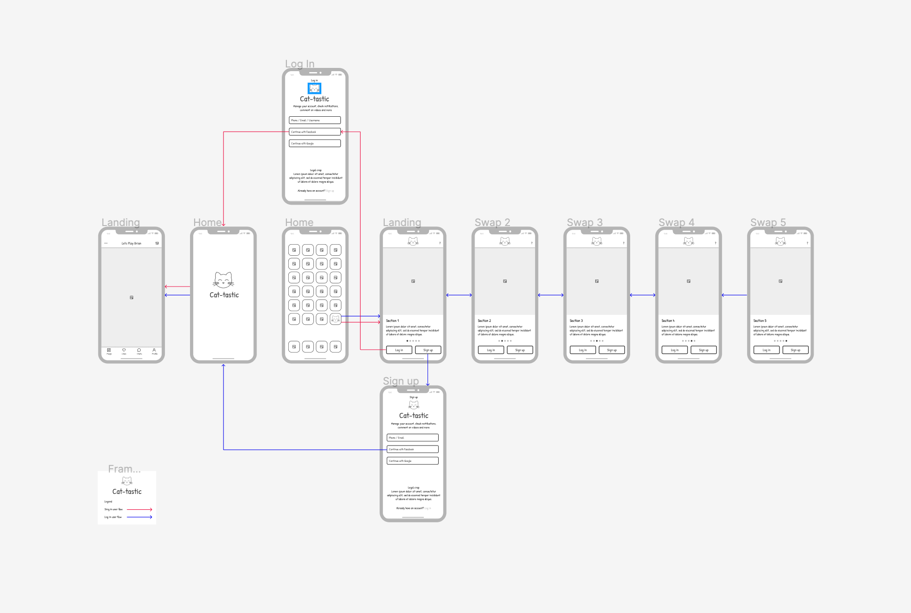
Add photos and screenshots of your prototype

Slide 30
Affinity & Usability Testing
How did testing your prototype go?
Where were the pain points?
What was successful?
What did you learn?
OUT OF SCOPE

Slide 31
OUT OF SCOPE
Add photos and screenshots of your affinity or usability testing

Slide 32
Iteration
What did you change?
How did you approach making changes?
Why did you change those things?
What were the results of changing them?
OUT OF SCOPE

Slide 33
OUT OF SCOPE
Add photos and screenshots that show how your solution has changed in response to research insights

Slide 34
Conclusion
Results
Challenges
Lessons Learned
Opportunities
Where things ended

Slide 35
Results
Solution Results
Improved the sign up flow saving users time and effort while driving additional revenue for the business (eg., Increasing customer sign up, increasing conversion rate and decreasing form abandonment)
Was it successful? Did it fail?
Even though testing was out of scope for this project, I revisited my original interviewee and conducted a quick test and she found the prototype to be efficient and user friendly.
“Wow, that was easy! You really listened.” – Britney (Interview2)
Notes:
What were the ultimate results of your solution?
Was it successful? Did it fail?
Why?
Remember - it’s okay to create a solution that fails.
What’s important is what you learned.

Slide 36
Challenges
What challenges did you face while creating and testing this solution?
Challenge: Not talking with true stakeholders (ex. Don, Jan and/or Israel) explaining the what and why. Solution: We created a fictious stakeholder.
Challenge: Conducting research under time constraint - 2 of the 4 interviewees cancelled last minute. Solution: We created a survey, both qualitative and quantitative
Challenge: Deciding which problem to solve. Solution: Kept referencing the problem statement and avoid herding cats
What part was hardest?
Gathering to overcome tight deadline
How did you overcome it?
Scheduled weekly meetups, standups, slack to communicate findings
Notes:
What challenges did you face while creating and testing this solution?
What part was hardest?
How did you overcome it?

Slide 37
Lessons Learned
What did you learn?
The UX value
Following the User Centered Design process and collaboration can change the trajectory of a project
Research is critical
Talk more with Stakeholders – Understanding the “what” and “why”
Discussion Guide – Listen more to the user and ask more “why” questions
Do not guard your work – Keep an open door policy. Some of my material could help teammates
Schedule 1:1 interviews early and have backup plan
What takeaways would you share with others?
All the above
What will you apply in the future?
All the above
Notes:
What did you learn?
What takeaways would you share with others?
What will you apply in the future?

Slide 38
Opportunities
What opportunities are still left in this solution?
To speak with stakeholders
What would you do differently, if given the chance?
Speak with stakeholders
If you were moving forward with another iteration, what direction would you take?
Speak with stakeholders

Slide 39
Q&A

